Slide 1
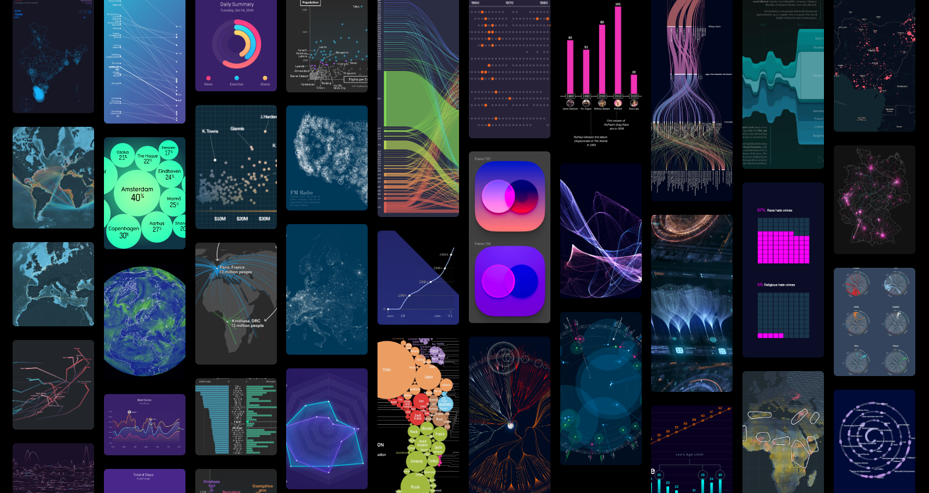

R
in the
Dataviz Universe
Yan Holtz
A travel by Yan Holtz

Slide 2

Hi, I’m Yan !
And I data visualization
❤️
Notes:
I’m yan
J’ai bosse dans

Slide 3
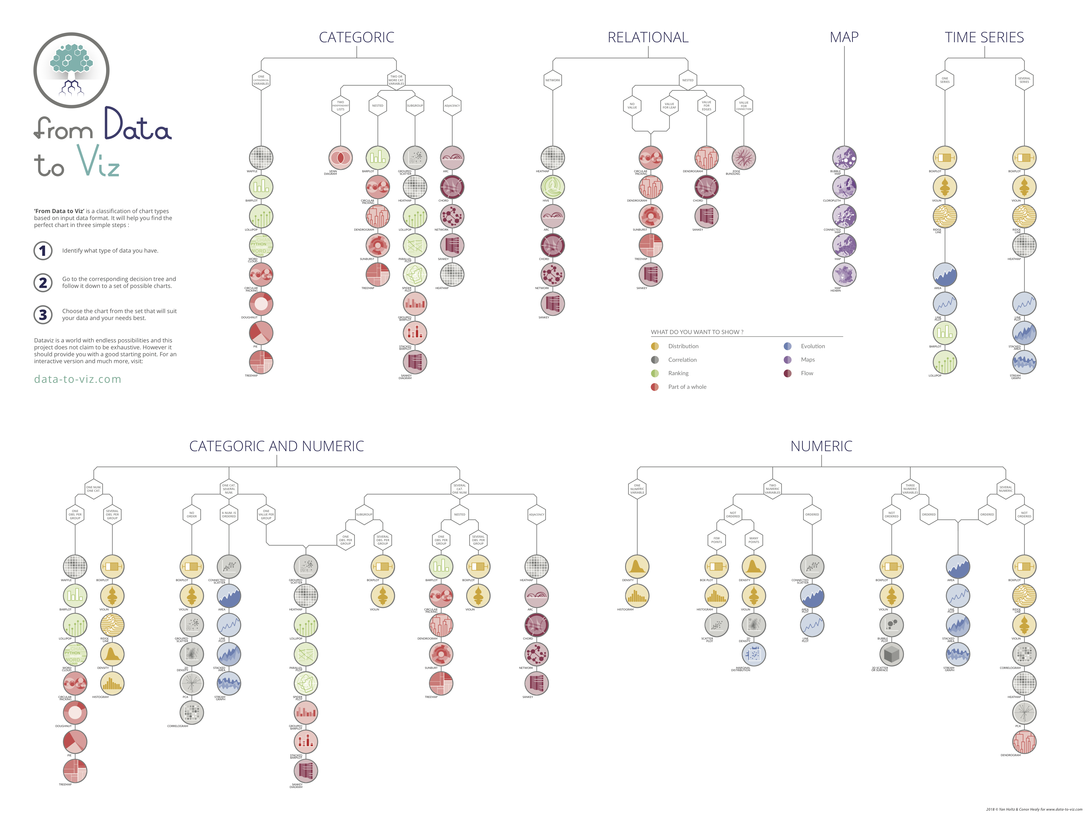
A universe of
graph types
Data-to-viz.com
Notes:
Poster is avail on the web!

Slide 4

I tech
❤️

Slide 5
R
Python
Data wrapper
Html
I Tech
❤️
D3.js
Shiny
React
Canvas

Slide 6
Vega
R
Gatsby
Tailwind
Python
ggplot2
Leaflet
Data wrapper
Tidyverse
Plotly
Html
R Studio
I Tech
❤️
Next.js
D3.js
VS code
Illustrator
Shiny
Github
SVG
React
Bokeh
React-spring
Canvas
Seaborn

Slide 7
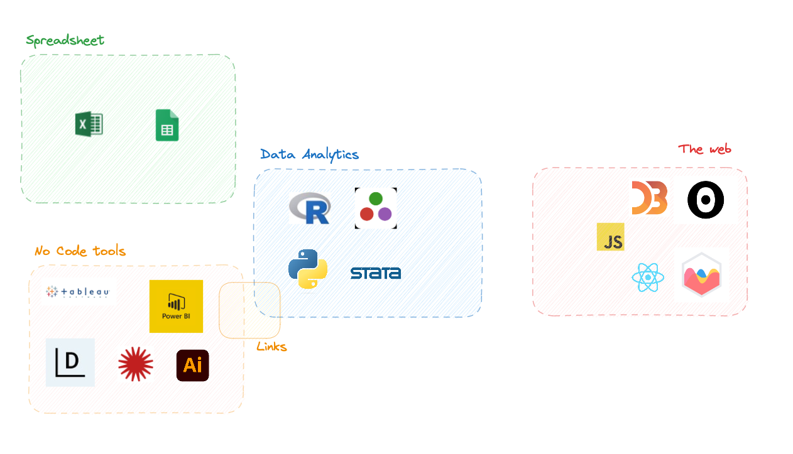

Slide 8
😱😱😱😱

Slide 9
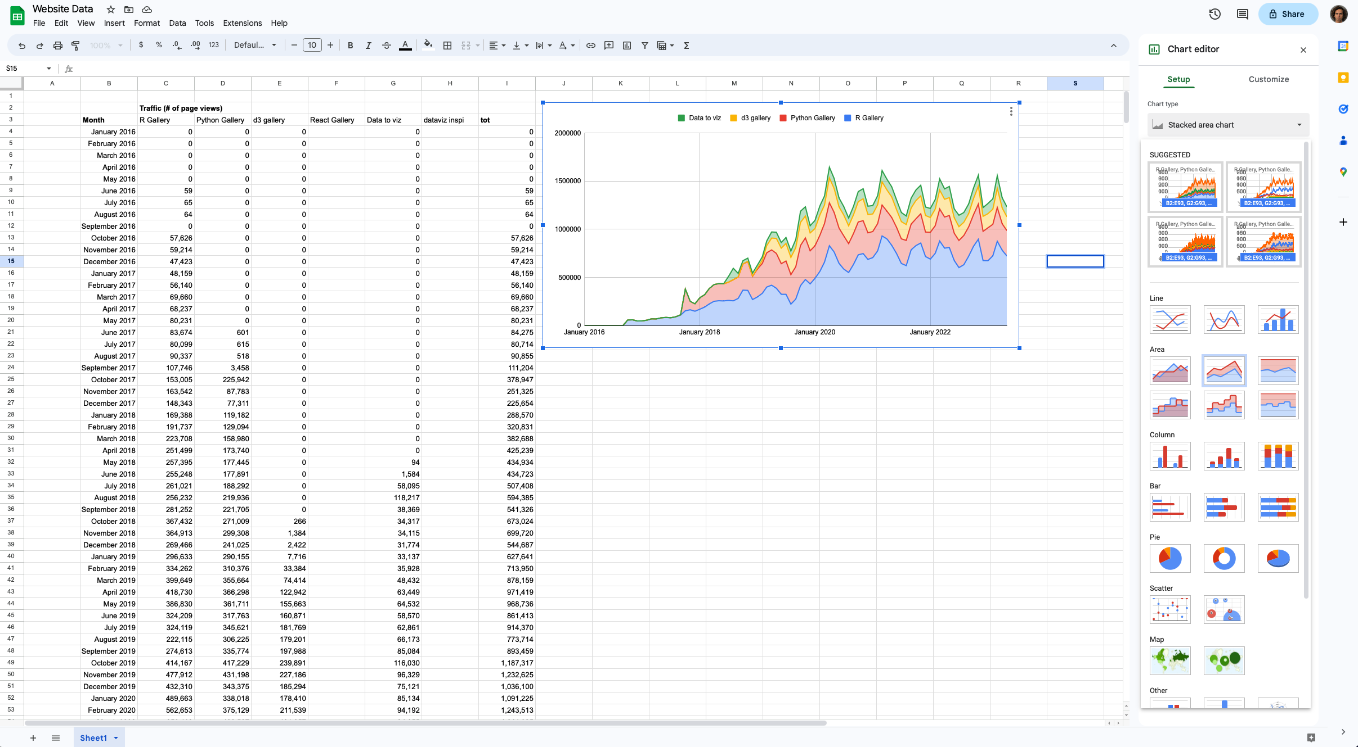
✅
✅
Quick
Easy
Notes:
Caveats are split in 3 main categories:
Dataviz
Data analytics
Reproducibility

Slide 10
✅
✅
Quick
Easy
❌
❌
❌
❌
❌
❌
❌
❌
❌ ❌
Graph defaults
Chart types
Interactivity
Data wrangling
Stats
Data size
Pipeline automation
Error prone
Collaboration
Versioning
Notes:
Caveats are split in 3 main categories:
Dataviz
Data analytics
Reproducibility

Slide 13
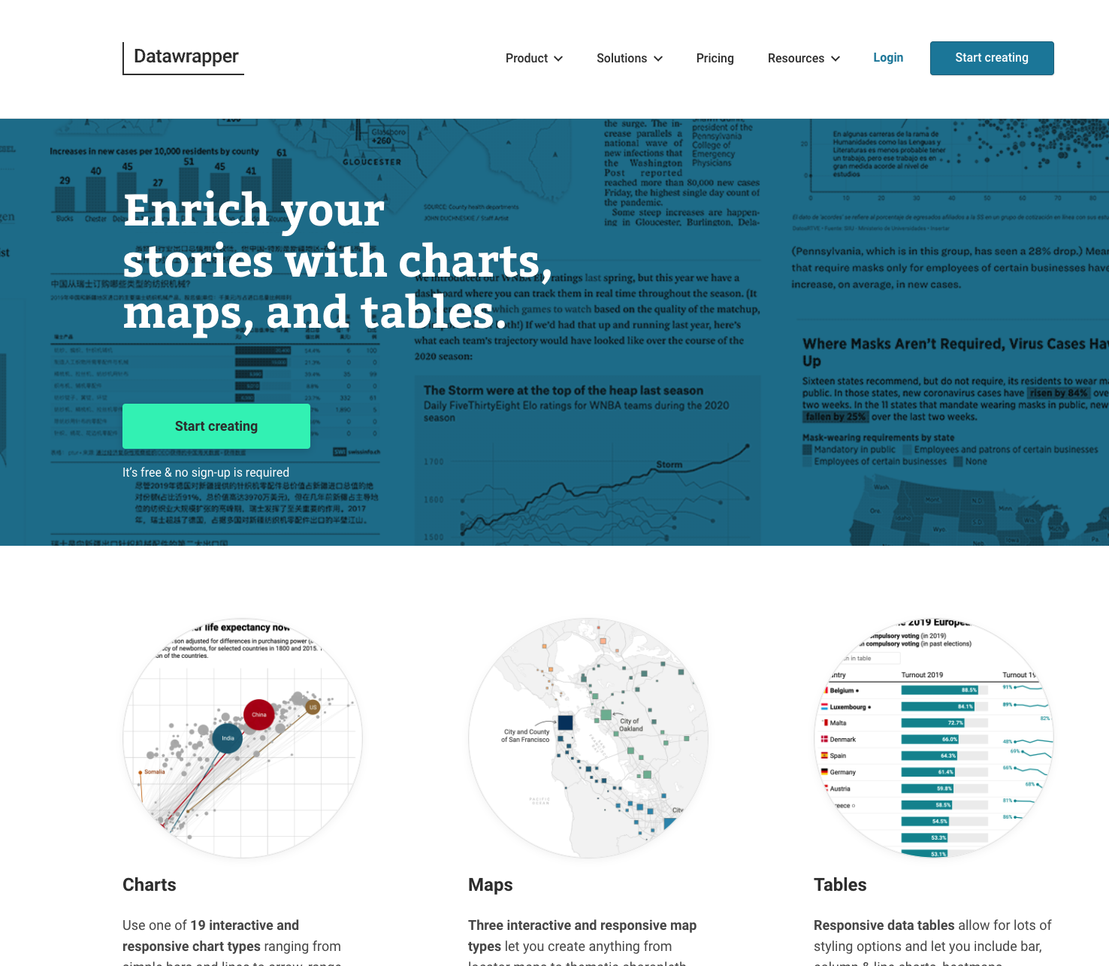

Slide 14
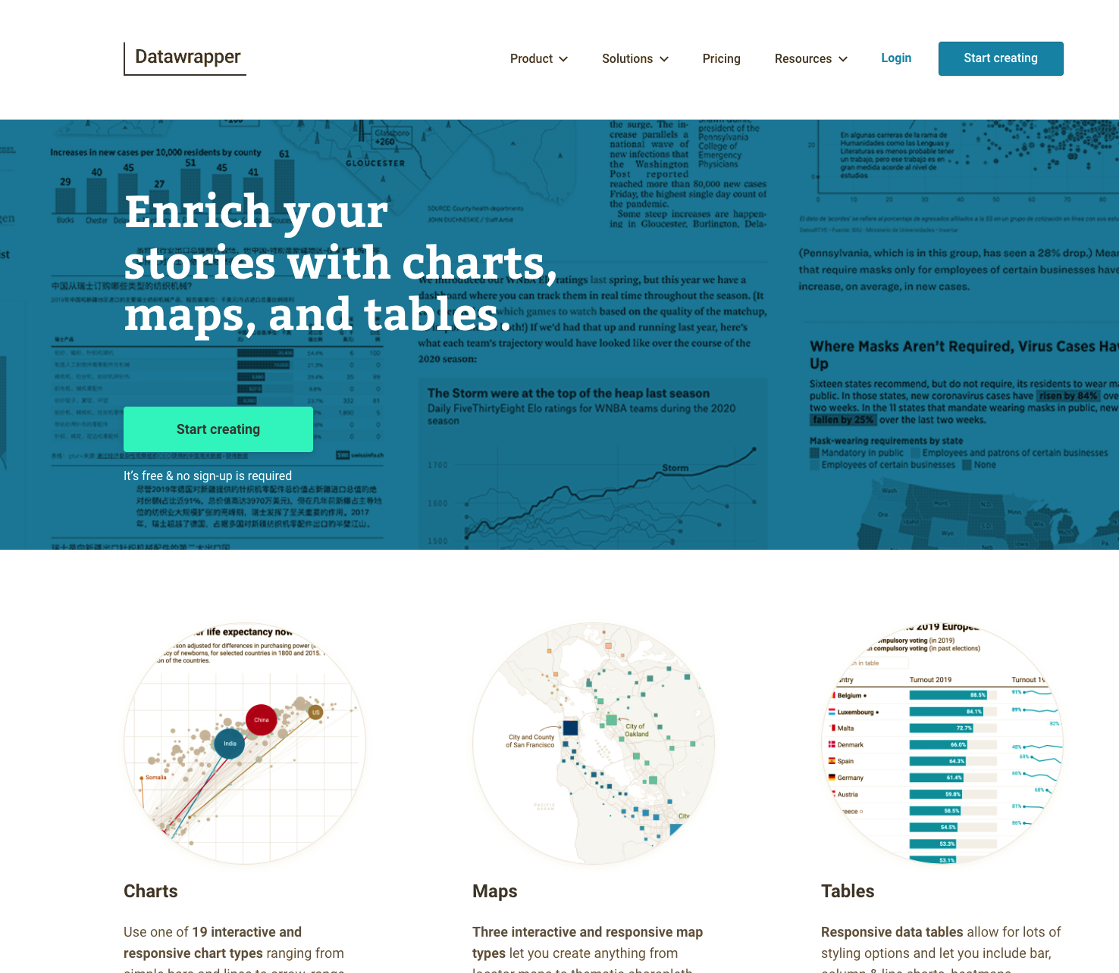
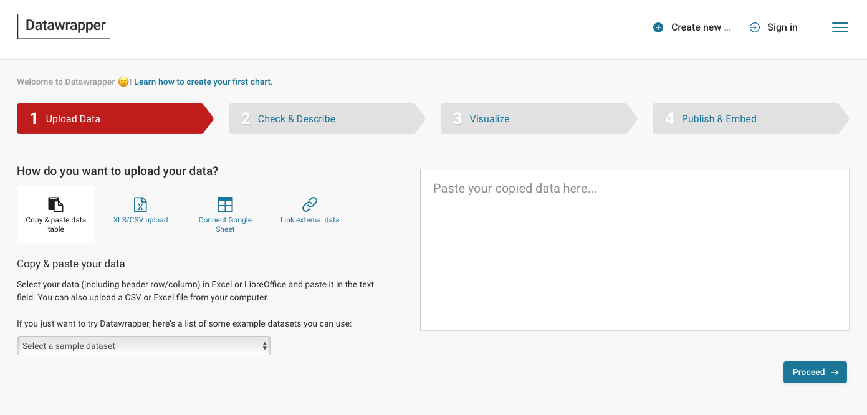

Slide 15
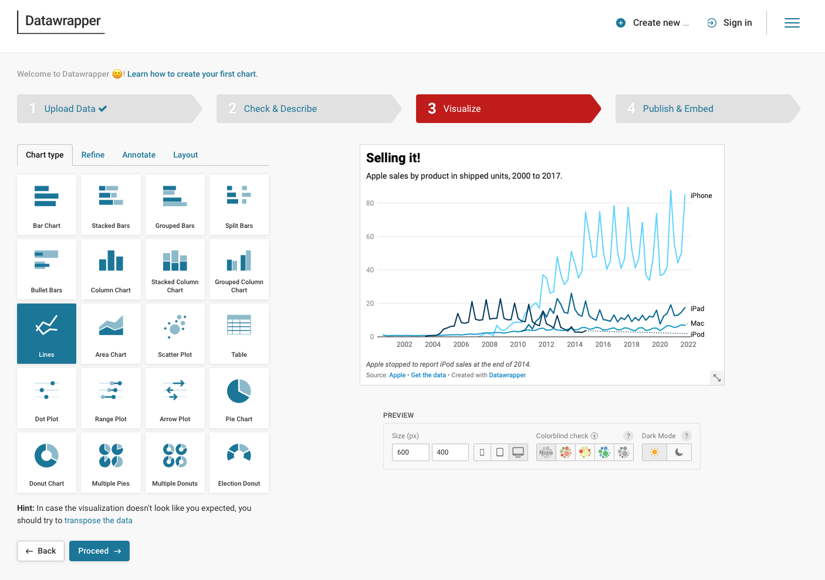
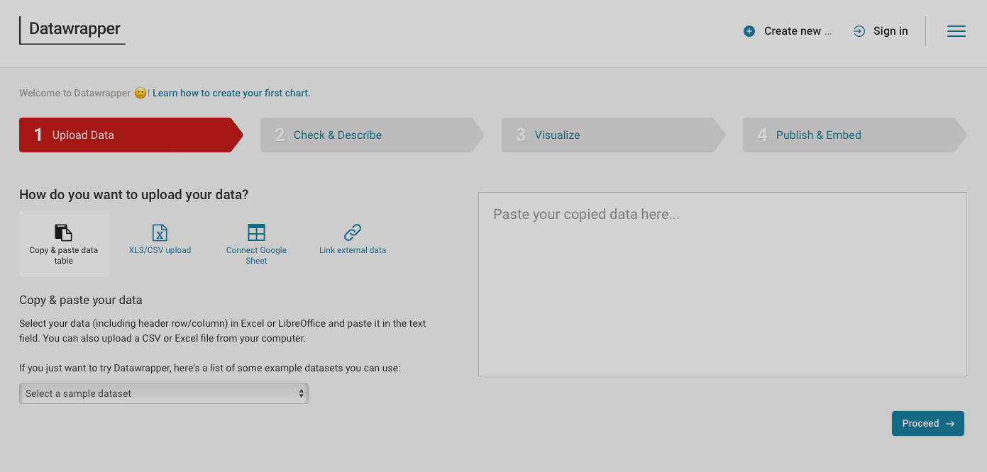
Notes:
Talk about academia
Et Gratuit!!

Slide 18
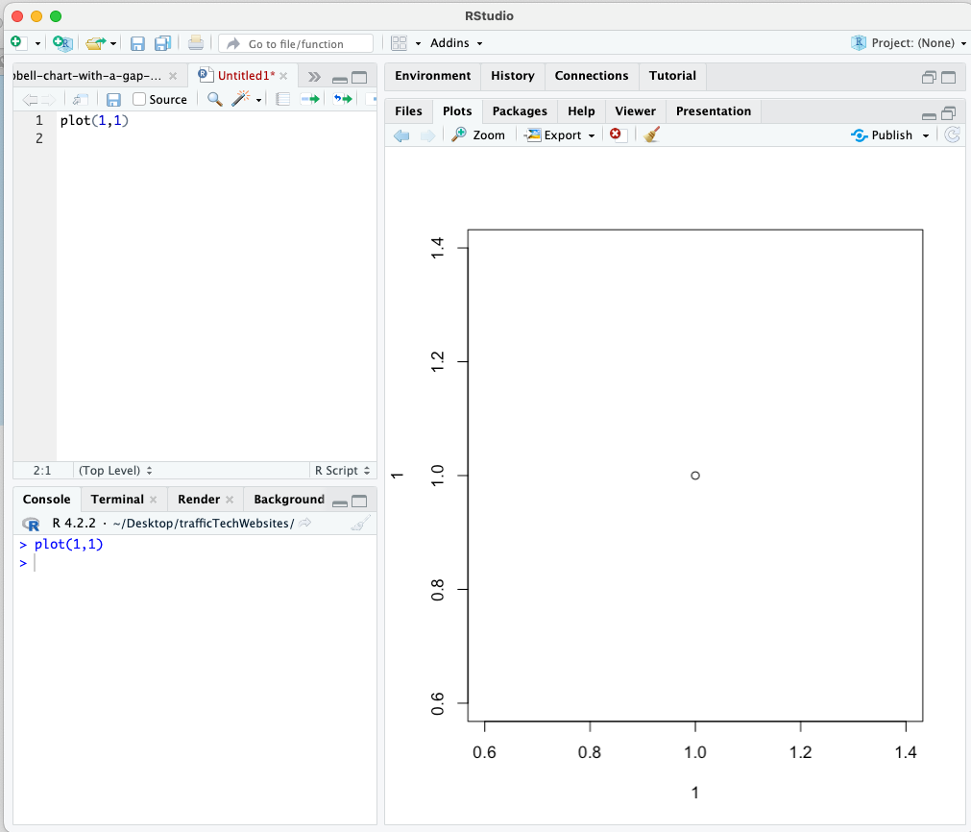
1995
🔥 😳
Notes:
Explain 1995

Slide 19
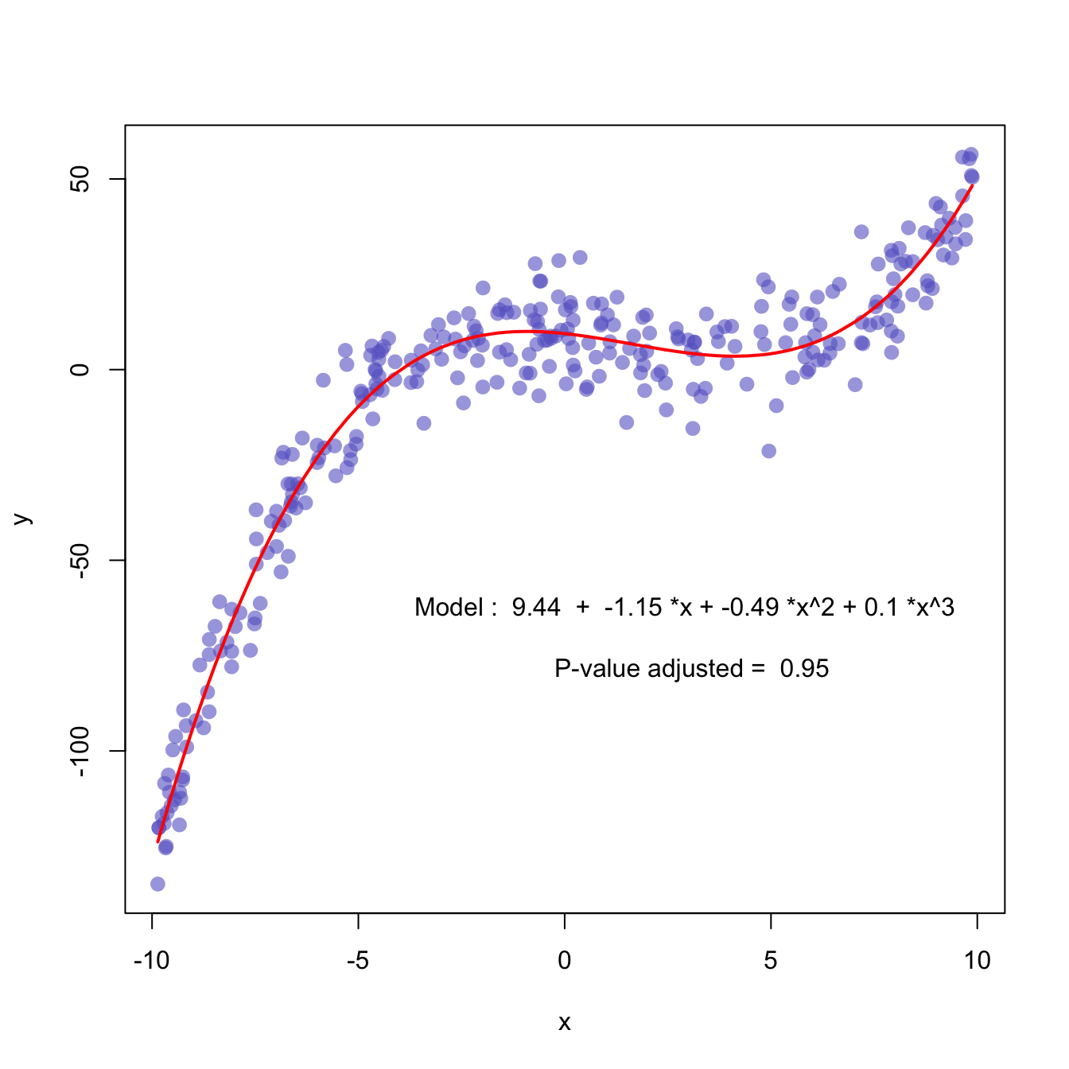
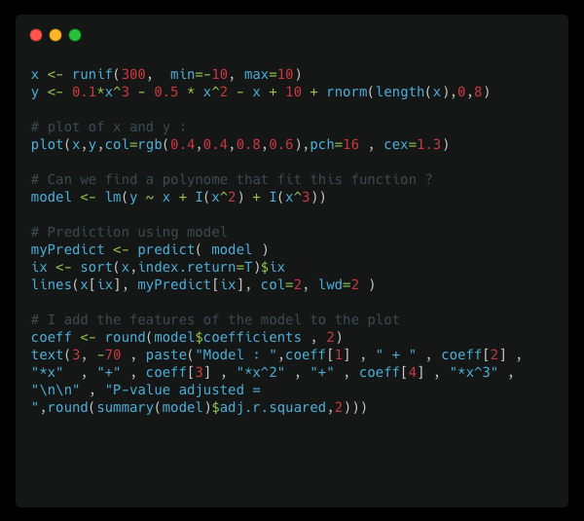
1995
Base R
😃 😞
but
Notes:
Le monde sans le tidyverse. Vous voyez un graph en 2 sec vous savez que c’est du R.
Pas de grammar of graphic
Difficile de customiser les graphs
Pas trop d’example en ligne.
- Pas de bonne doc.
Je cree la gallery en passant mes nuits a explorer les examples des packages.
Impossible de trouver des beaux graphs fait en base R.

Slide 20
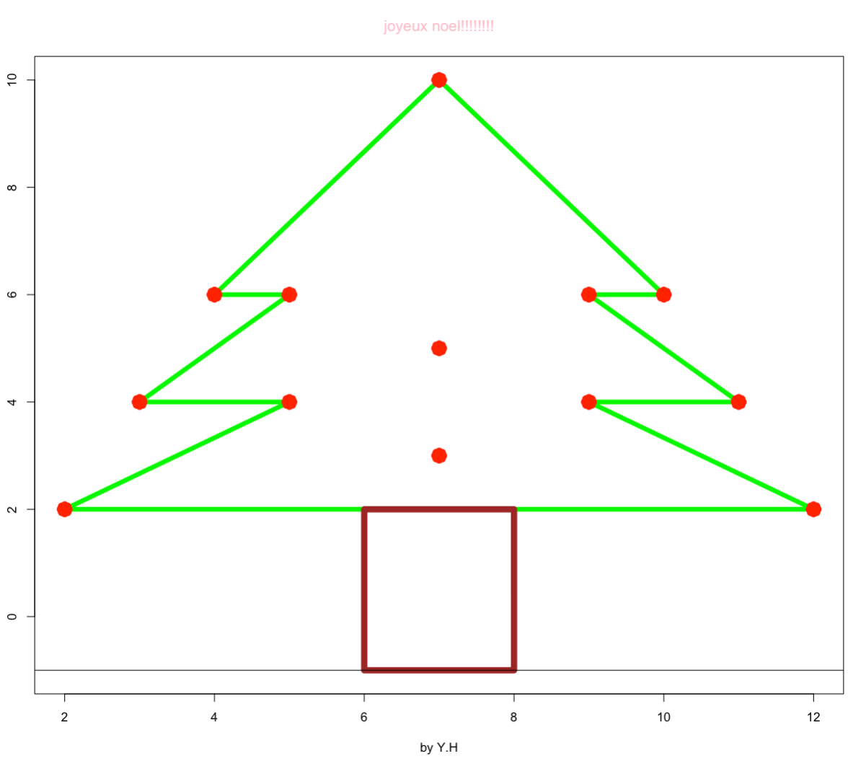
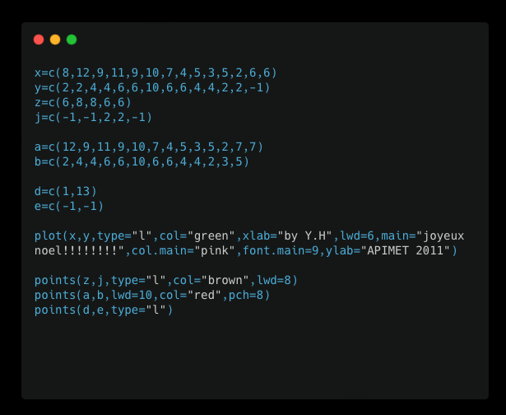

Slide 21
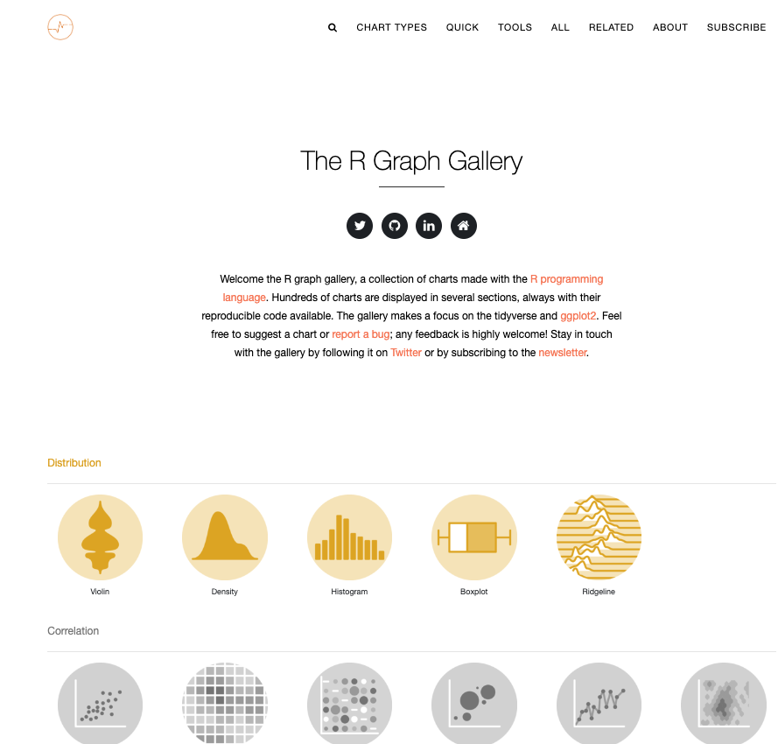
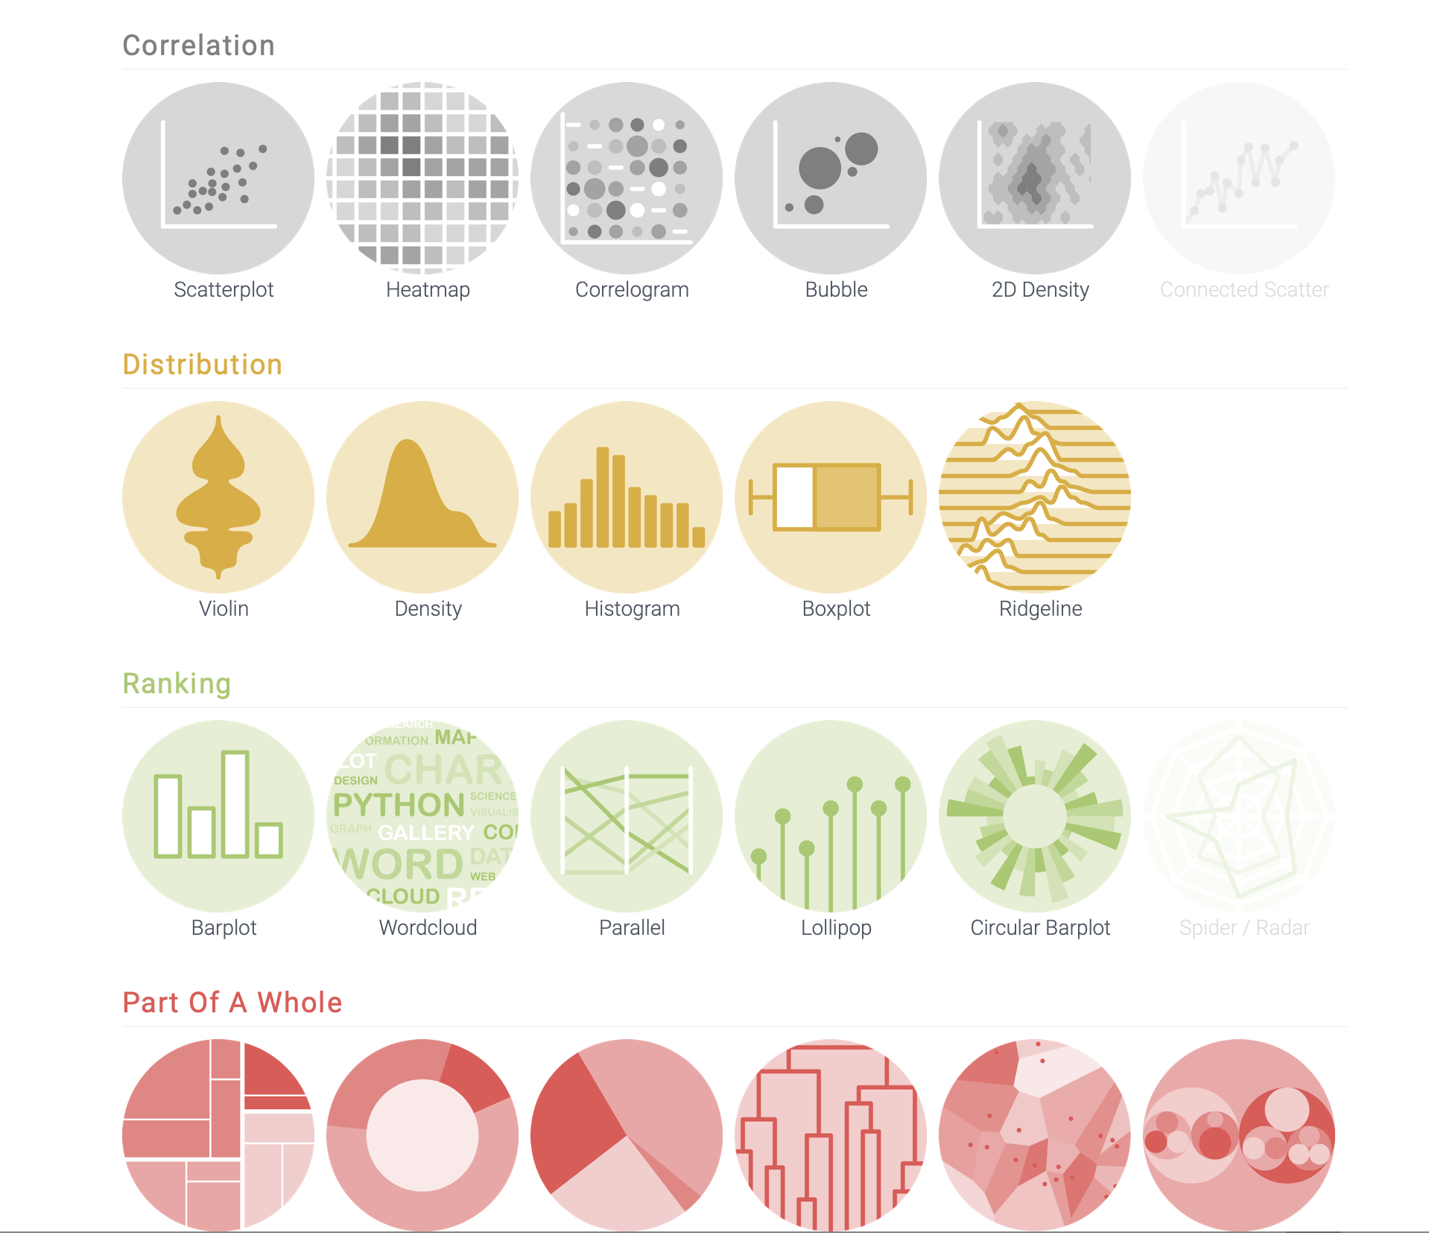
r-graph-gallery.com
✅
✅
✅
52 chart types
~ 400 chart examples (and growing) 800k visits / months

Slide 22
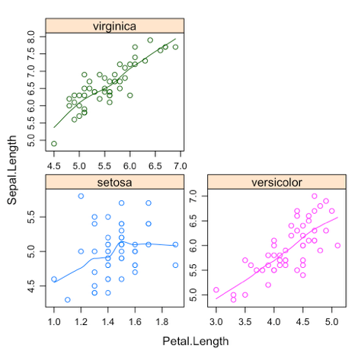
2001
Lattice
New API
Easy small multiples

Slide 23
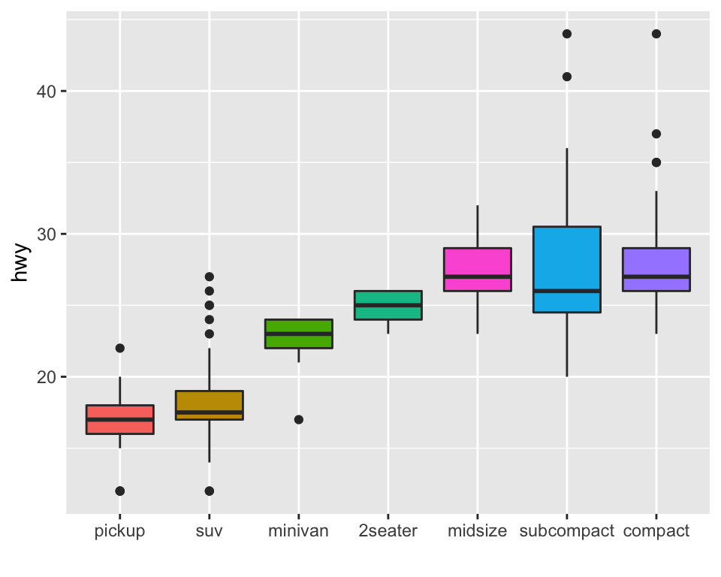

2007
ggplot2
A revolution
Notes:
Ggplot2 = big revolution
Everybody in the world of dataviz knows it
Python tried to mimick it
Even Javascript tried to mimick it

Slide 24
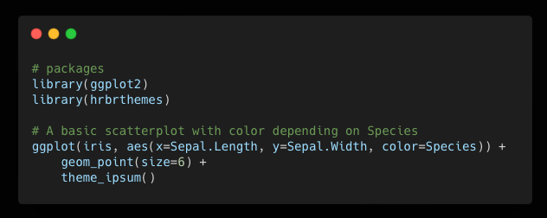
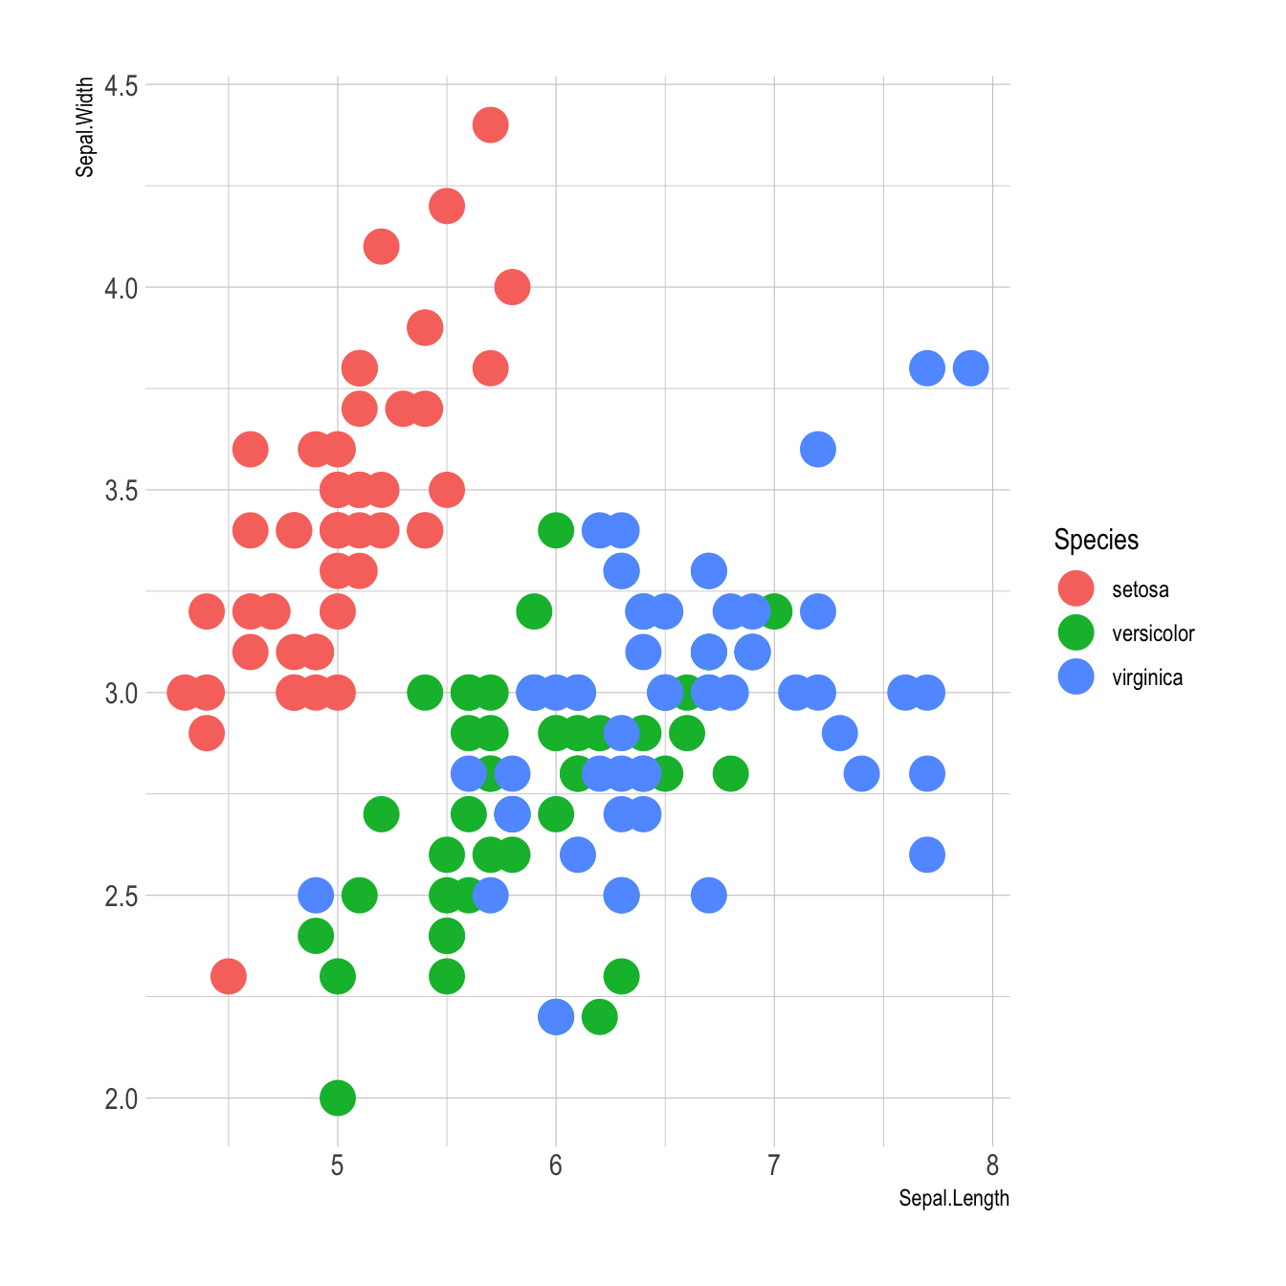
✅
✅
✅
✅
✅
✅
✅
✅
Consistent Grammar
Documentation
Good default
Concise
Flexible
Themes
Community
Small Multiples

Slide 25
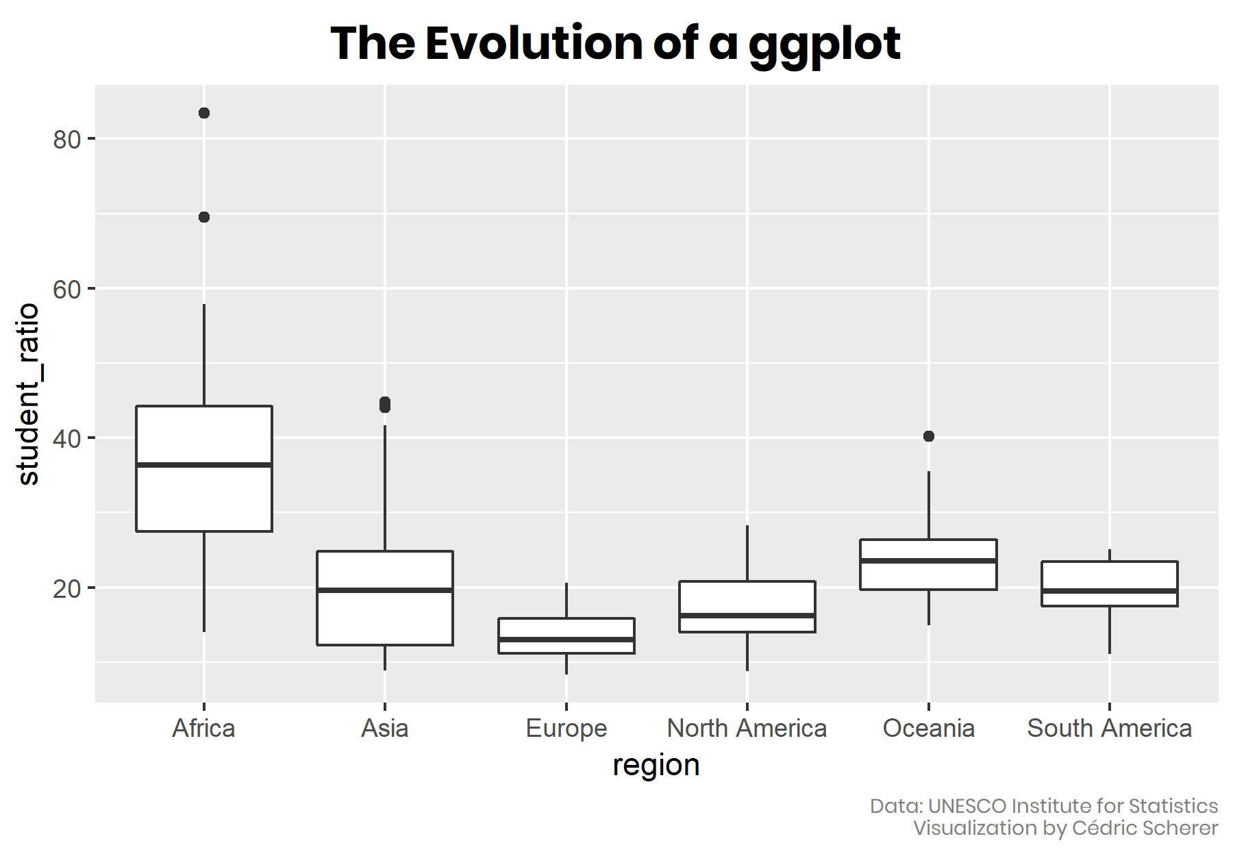
Customization
Cedric Scherer

Slide 26
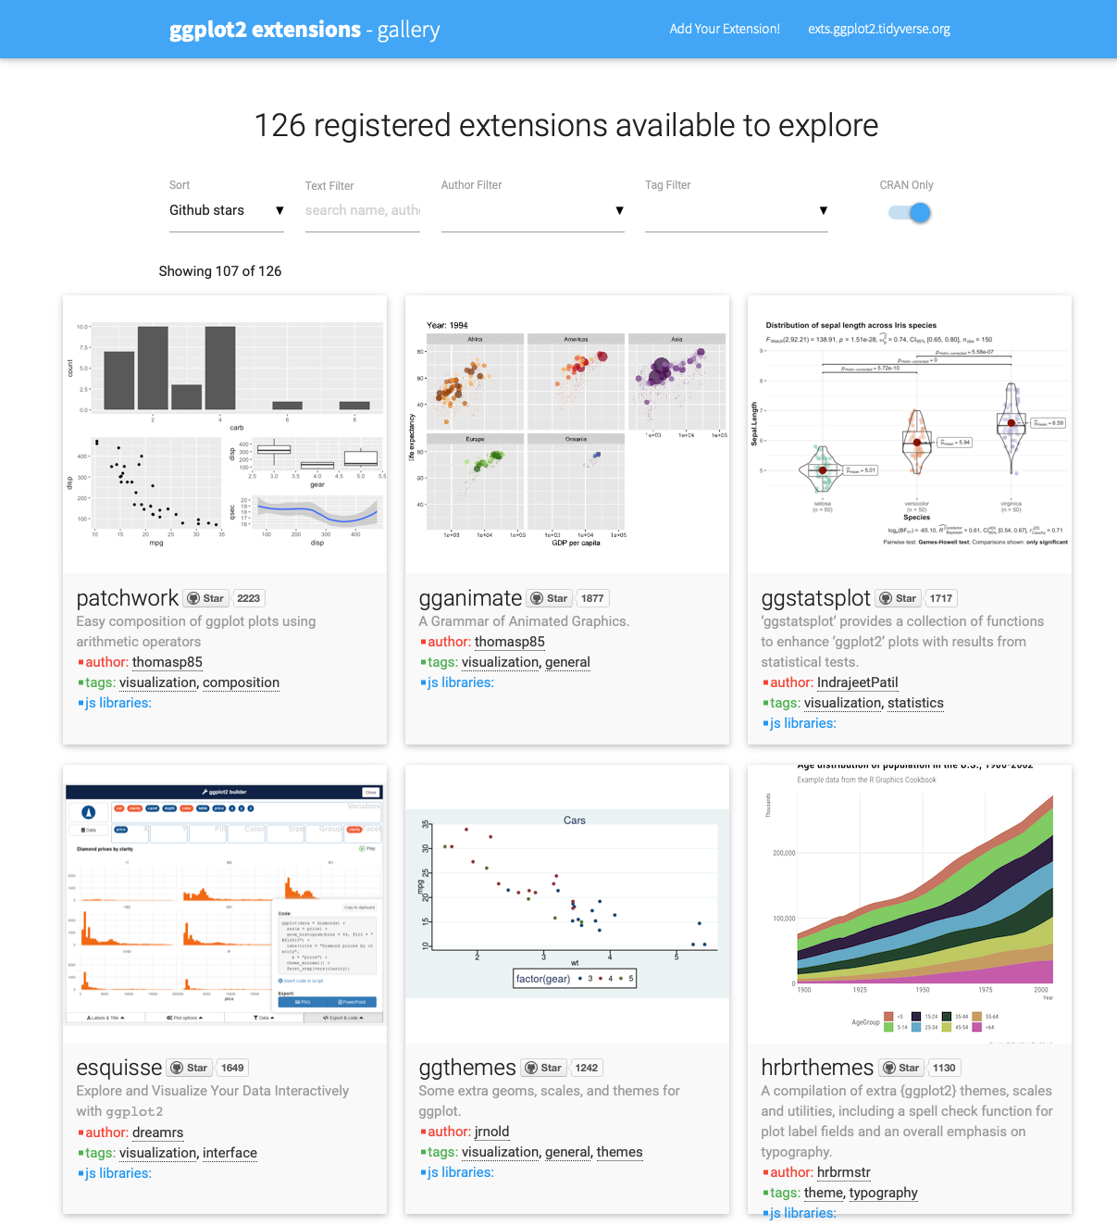
Ggplot2 extensions
exts.ggplot2.tidyverse.org
Notes:
Le monde sans le tidyverse. Vous voyez un graph en 2 sec vous savez que c’est du R.
Pas de grammar of graphic
Difficile de customiser les graphs
Pas trop d’example en ligne.
- Pas de bonne doc.
Je cree la gallery en passant mes nuits a explorer les examples des packages.
Impossible de trouver des beaux graphs fait en base R.

Slide 27
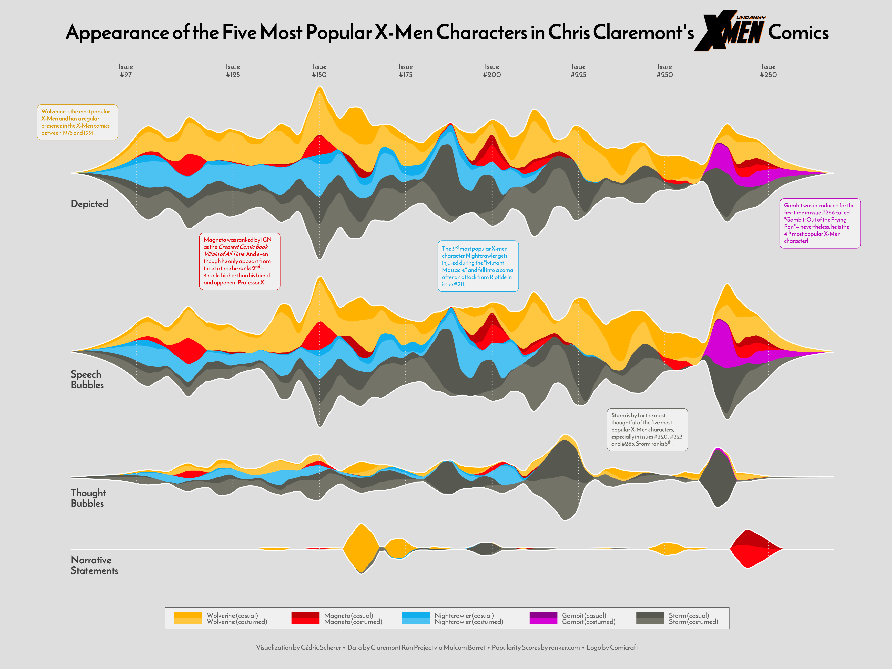
Cedric Scherer
X-Men Characters

Slide 28
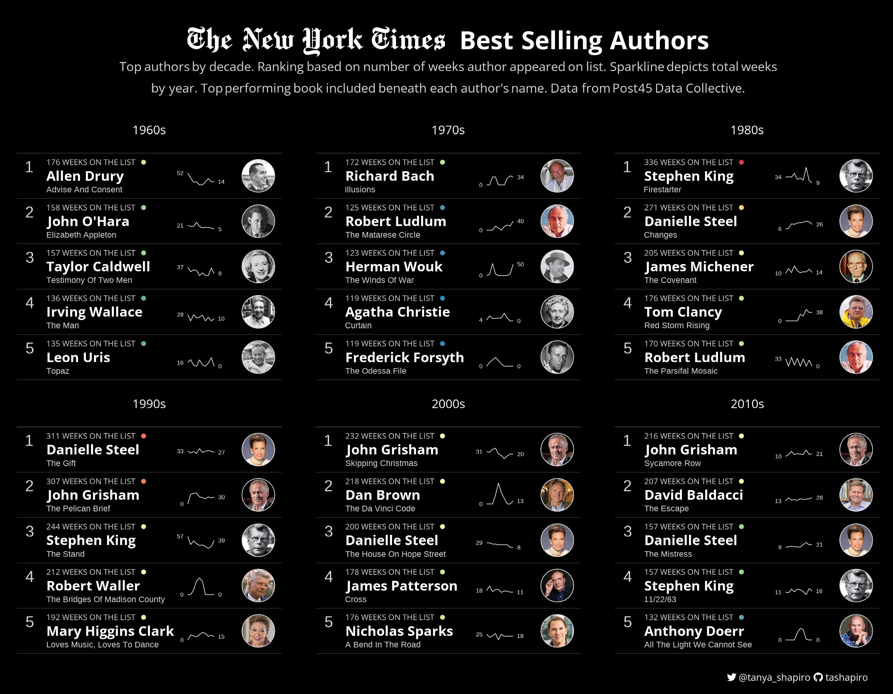
Tania Shapiro
Best selling Authors
Notes:
Briefly explain what the chart says

Slide 29
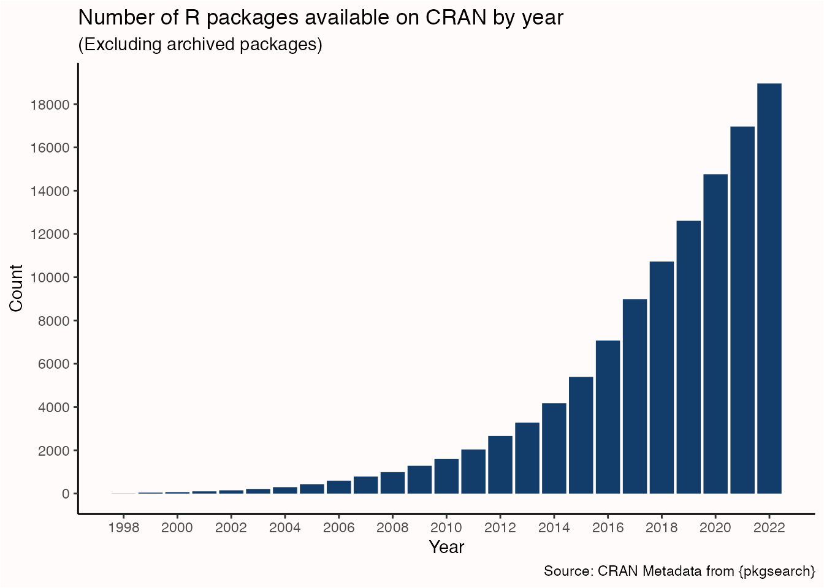
Tidytales.ca

Slide 30
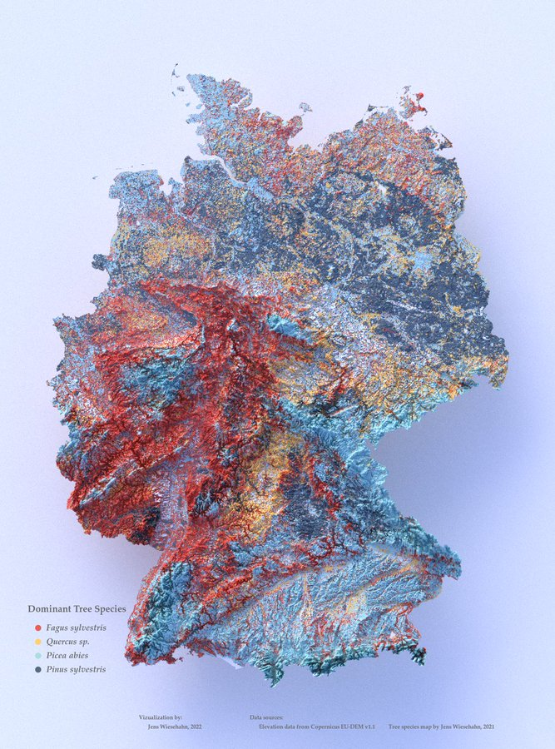
Jens Wiesehahn
Species Map (RayShader)

Slide 31
Exploratory
Explanatory

Slide 32
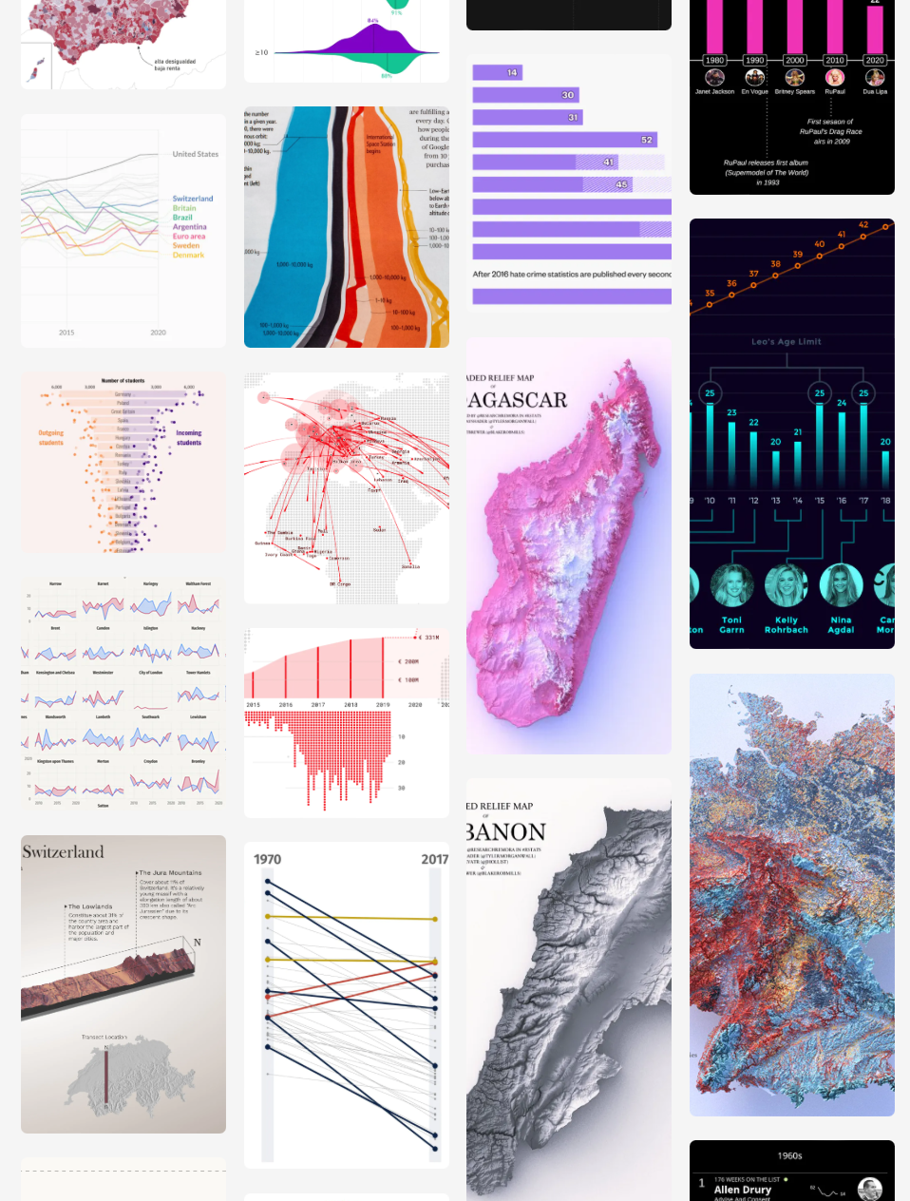
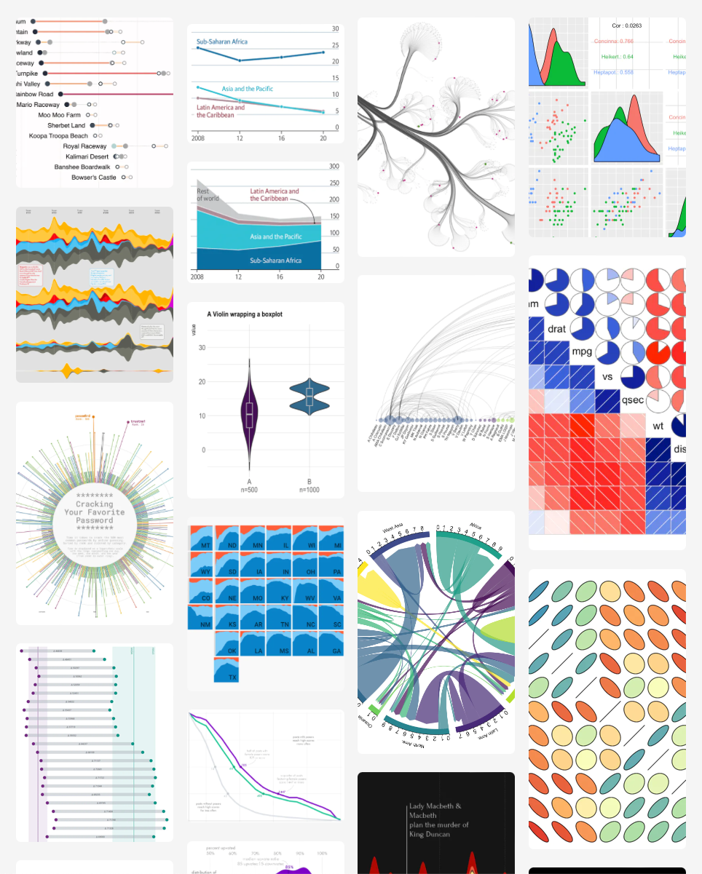
Dataviz-
inspiration.
com

Slide 33
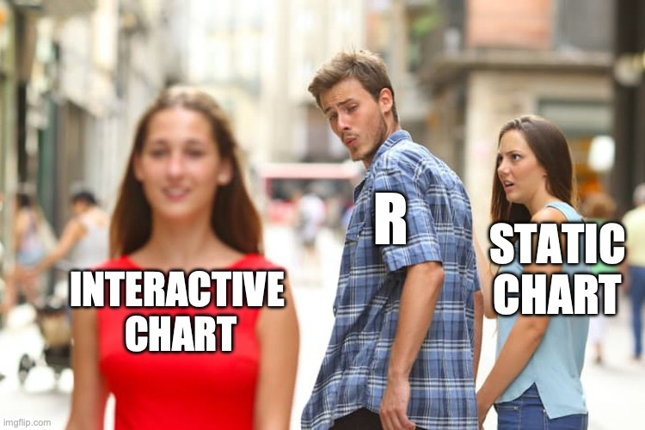

Slide 34
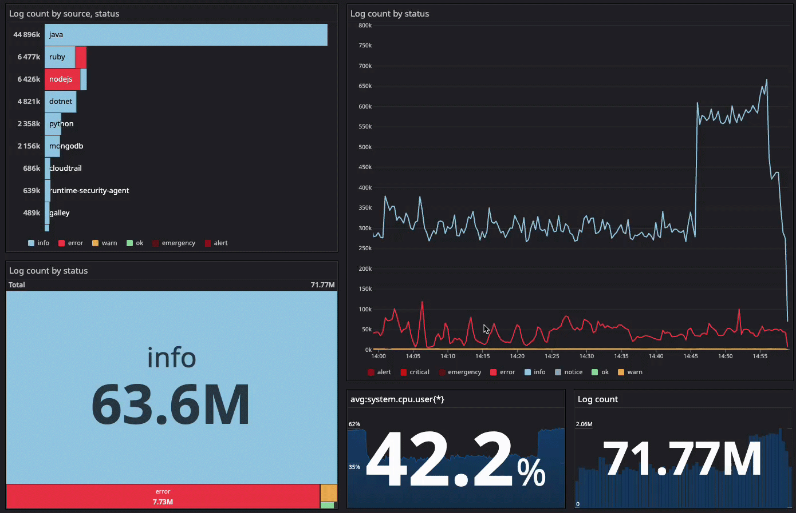

Hover effect
Tooltip Zoom Button
Scroll
Click
Dynamic data
Notes:
Define what an interactive chart is

Slide 36


+
browser
javascript
Notes:
Ne pas dire je vais vous apprendre a faire un site web

Slide 37
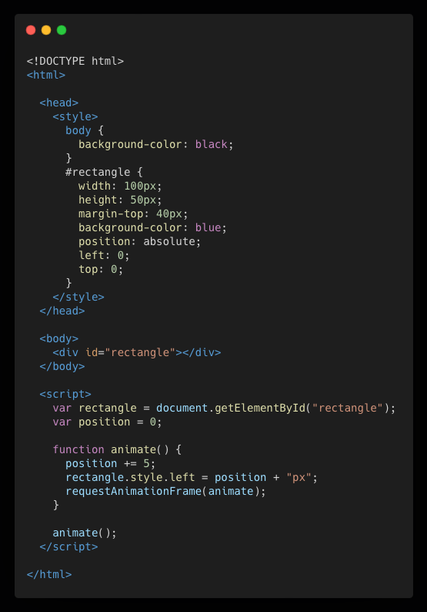
A very simple website made in HTML
HTML

Slide 38

Styled with CSS
CSS
HTML

Slide 39

Alive with Javascript
CSS
HTML
JS
Notes:
ON est plus dans R!

Slide 40
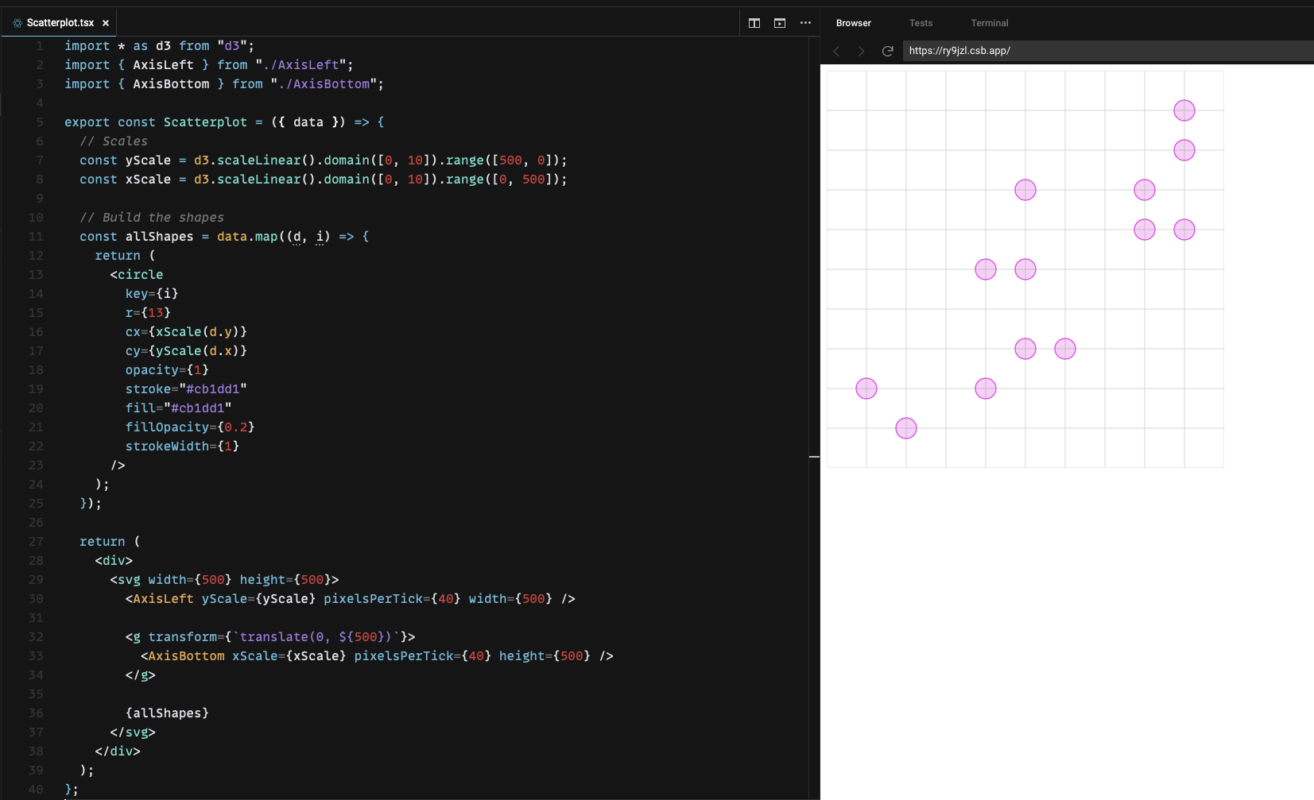

Slide 41
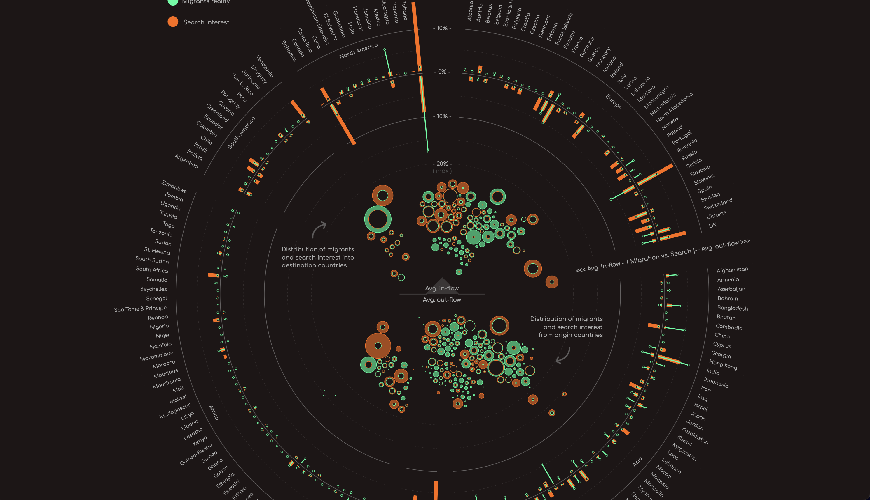
migrationinsearch.com

Slide 42
Flexibility:
Complexity:
👍🏽 👍🏽 👍🏽 👍🏽 👍🏽
😩 😭 🙇🏼‍♀️ 📈

Slide 43
Abstraction : D3.js
1️⃣
Flexibility:
Complexity:
👍🏽 👍🏽 👍🏽 👍🏽 👍🏽
😩 😭 🙇🏼‍♀️ 📈
Abstraction 2: : Other Chart libraries
2️⃣

Slide 44
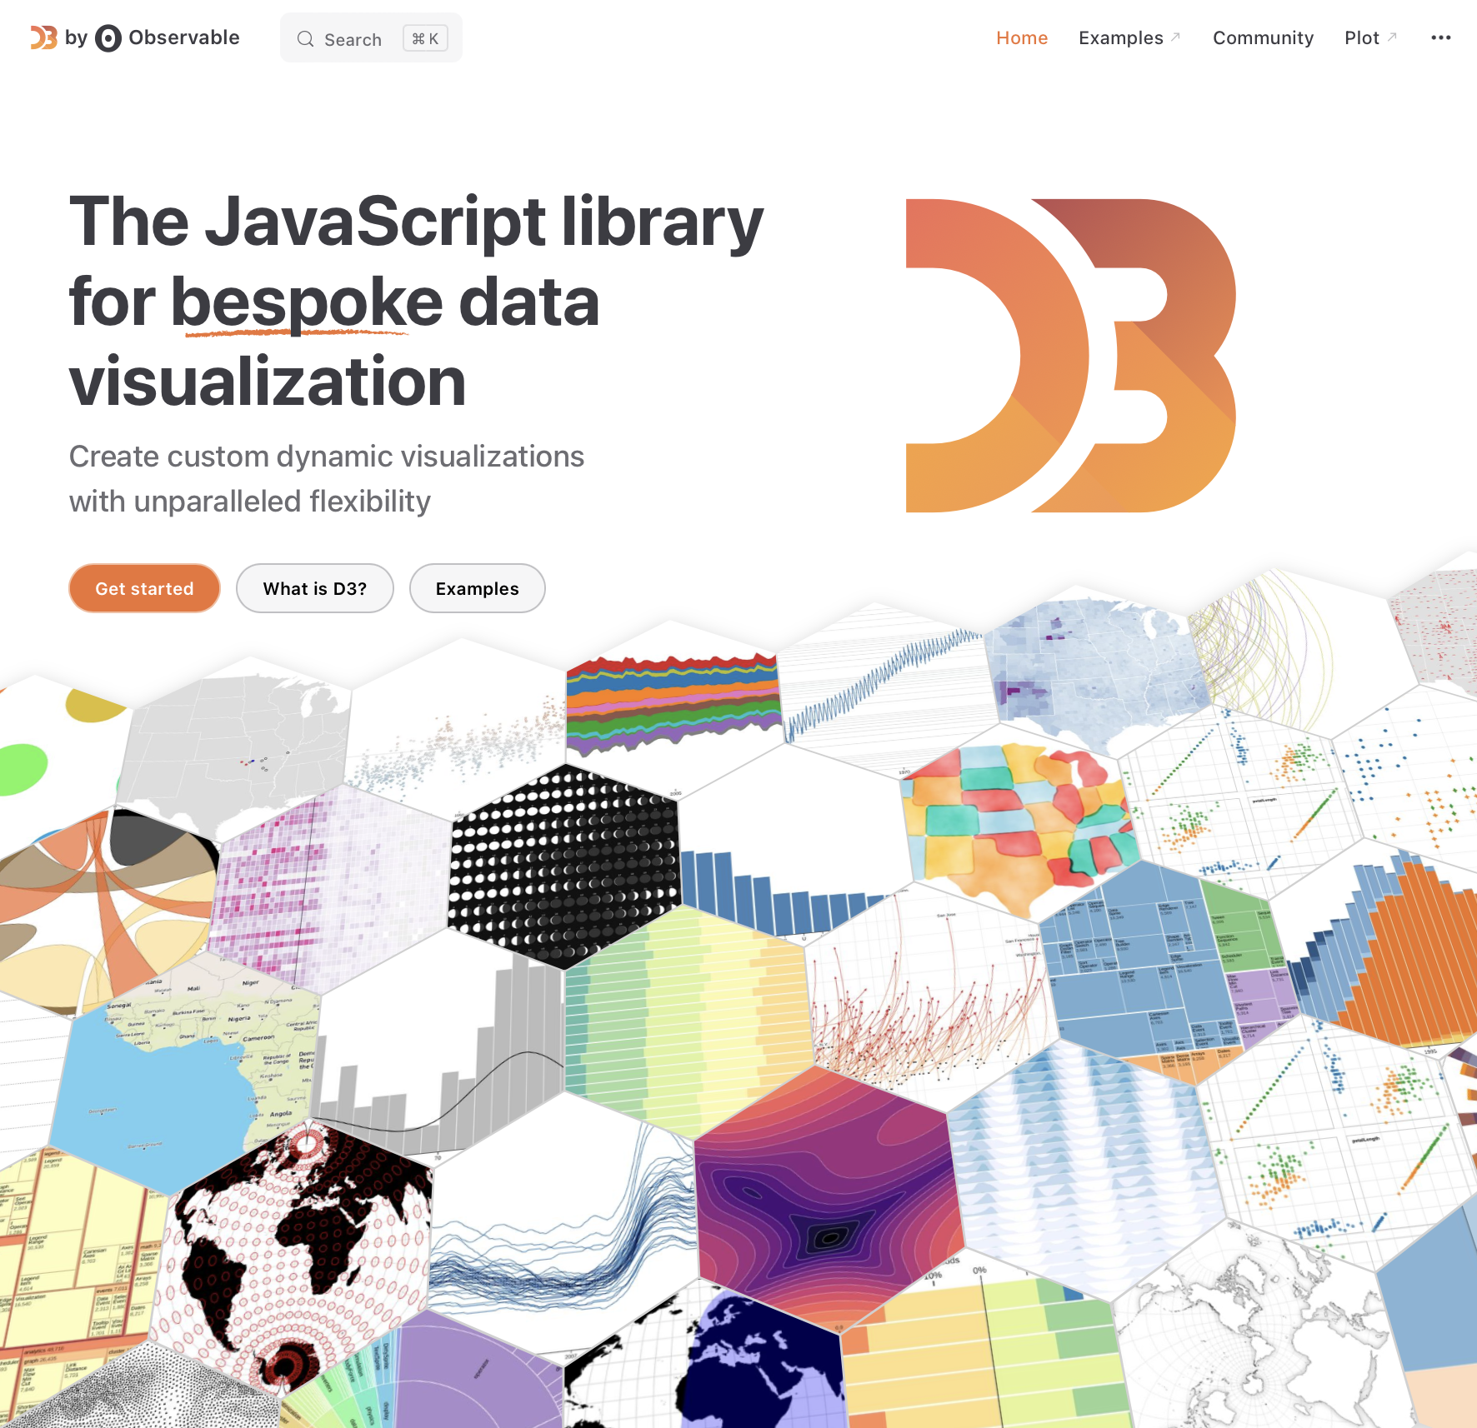
1️⃣
D3.js
D3 is limitless
d3-graph-gallery.com
d3js.org
Notes:
Explain that d3 is not a graphing library.
But just a set of utility functions
Wrapper = Encapsuler
Highlighter = Mettre en evidence

Slide 45

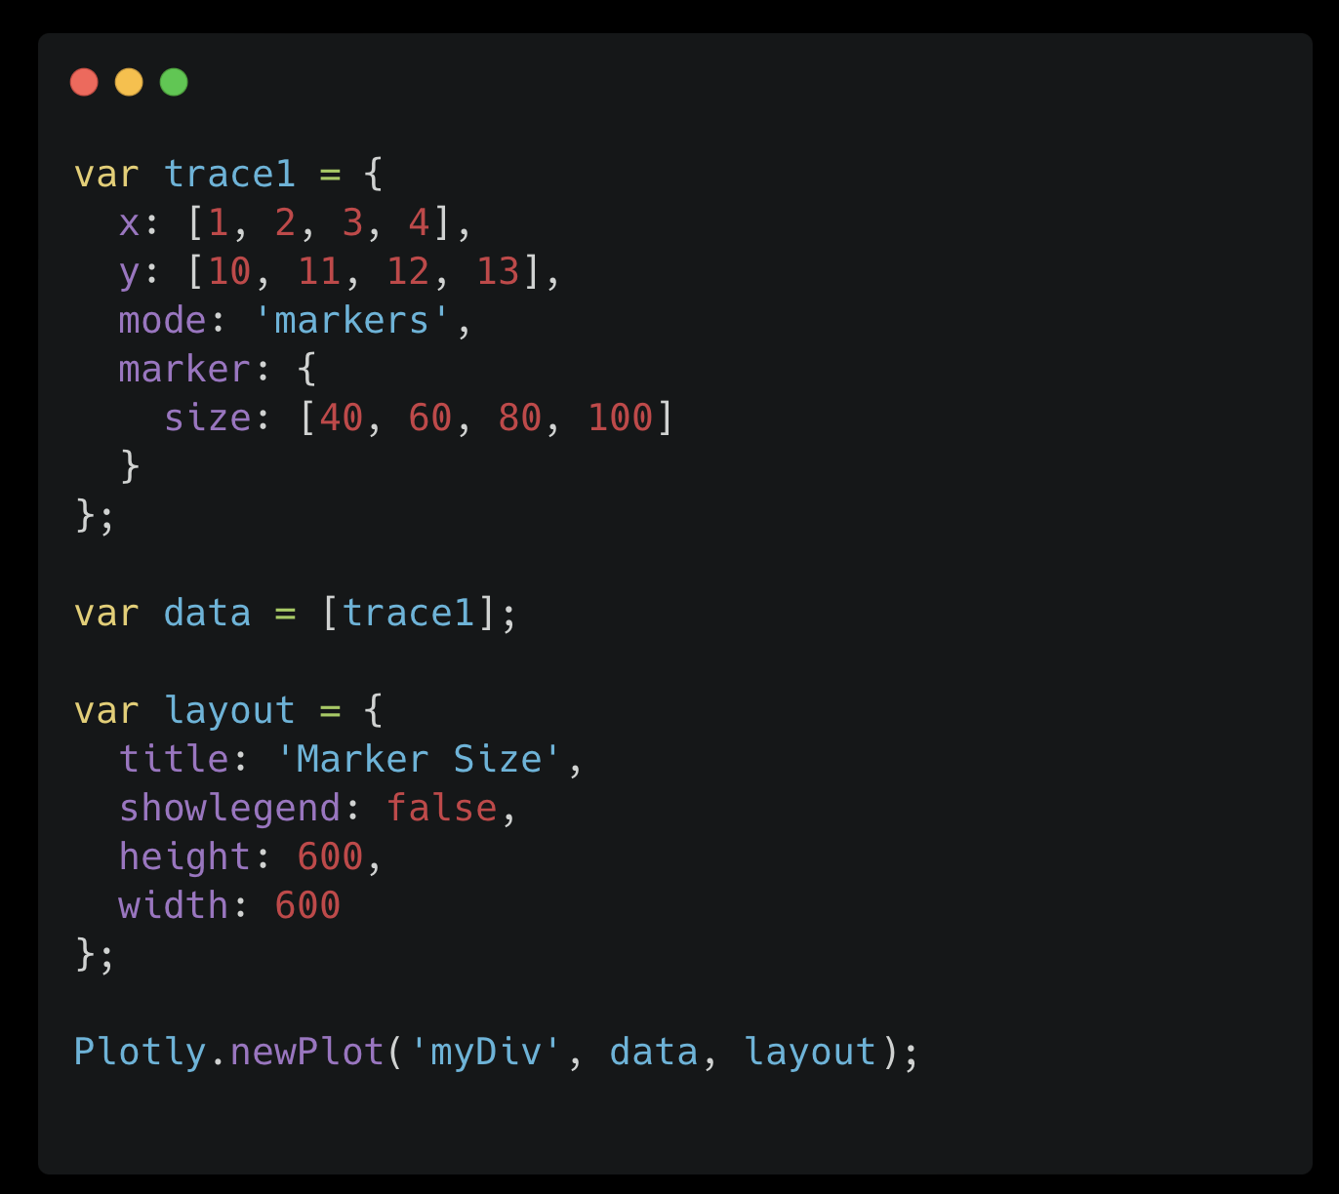
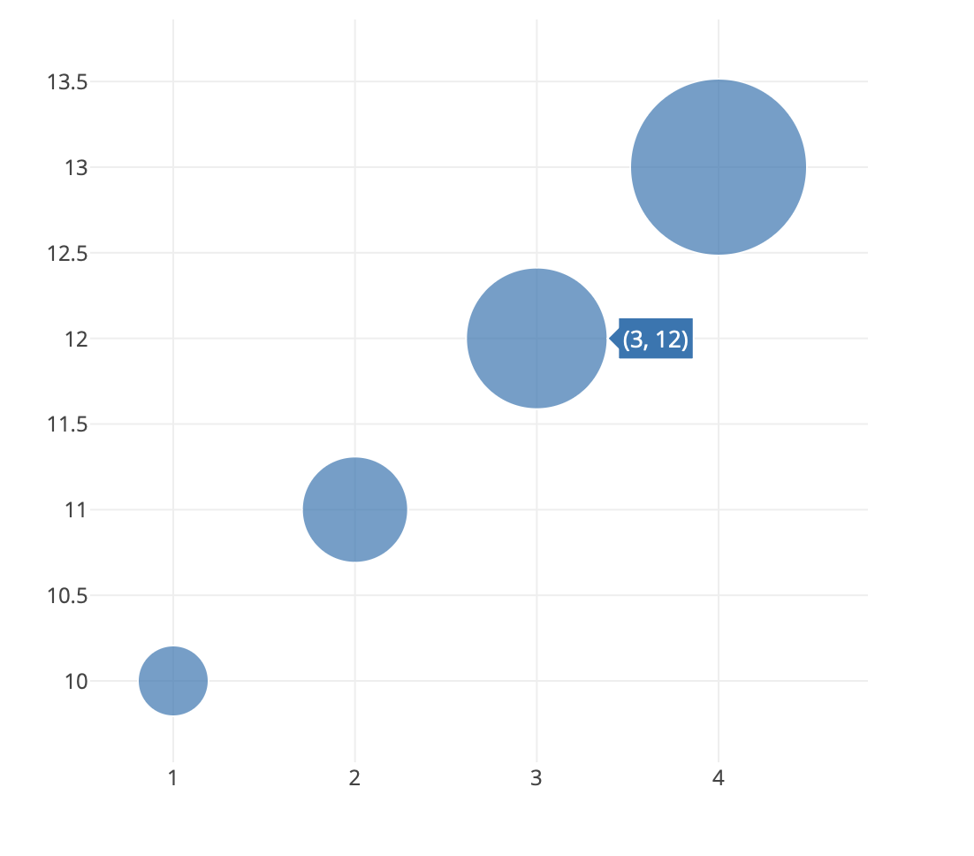
2️⃣
Other chart libraries
Notes:
Explain that d3 is not a graphing library.
But just a set of utility functions

Slide 46





And many many many many more !
Notes:
Also say that HTML widget lib can be used to wrap any piece of JS code

Slide 48
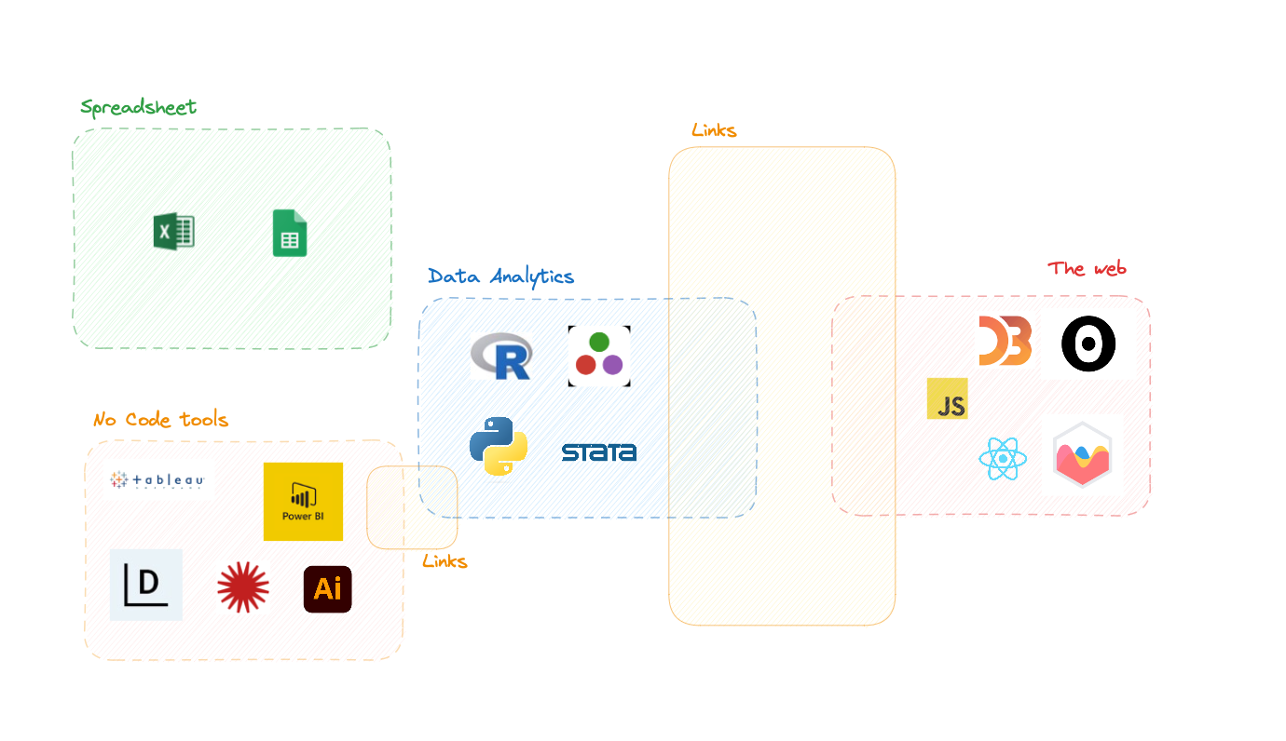
Notes:
Explain well that 3 types of bridges exist

Slide 49
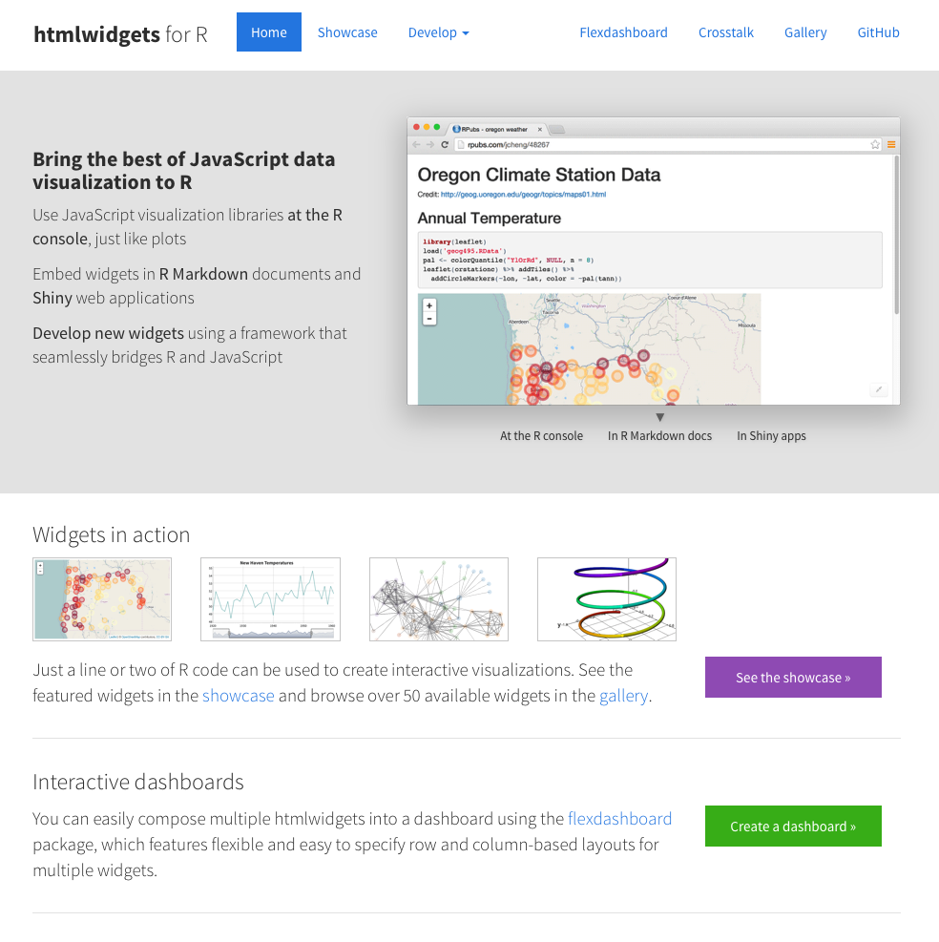
Bridge 1: R markdown. Describe the dream Pipeline
htmlwidgets.org
Bridge 2: HTML widgets
create R bindings to JavaScript libraries
Bridge 3: Shiny

Slide 50
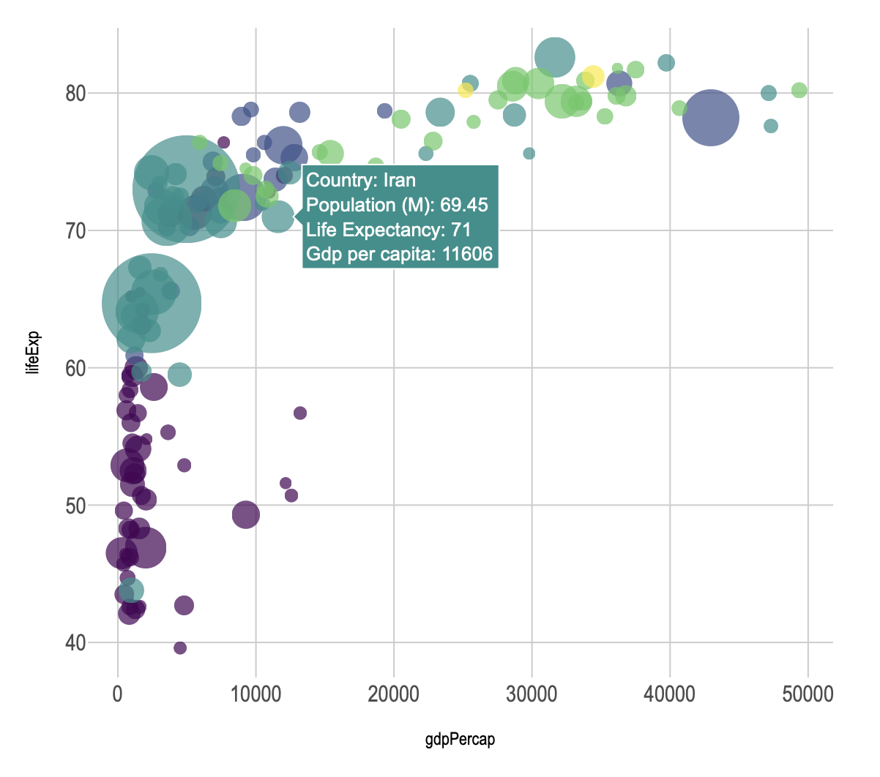
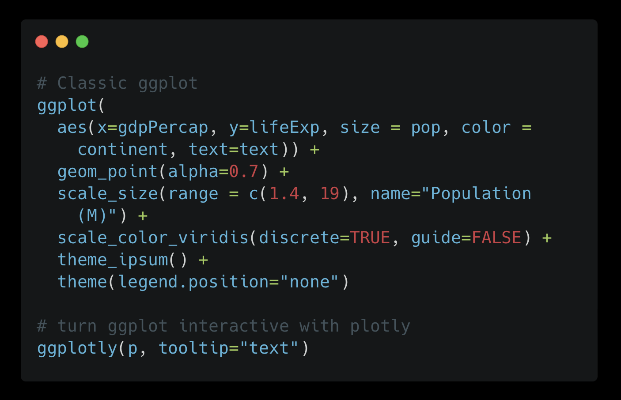
The R package !
😍

Slide 51
R Plotly > ggplot2 > Plotly.js > D3.js > Javascript
😍

Slide 52





Notes:
Also say that HTML widget lib can be used to wrap any piece of JS code

Slide 53
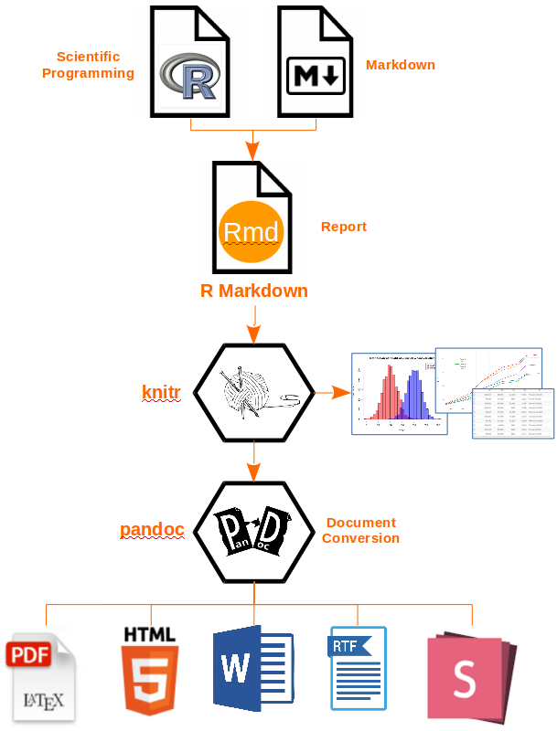

✅
✅
✅
✅
Reporting
Reproductibility
RENDER HTML !
Export a static website

Slide 54
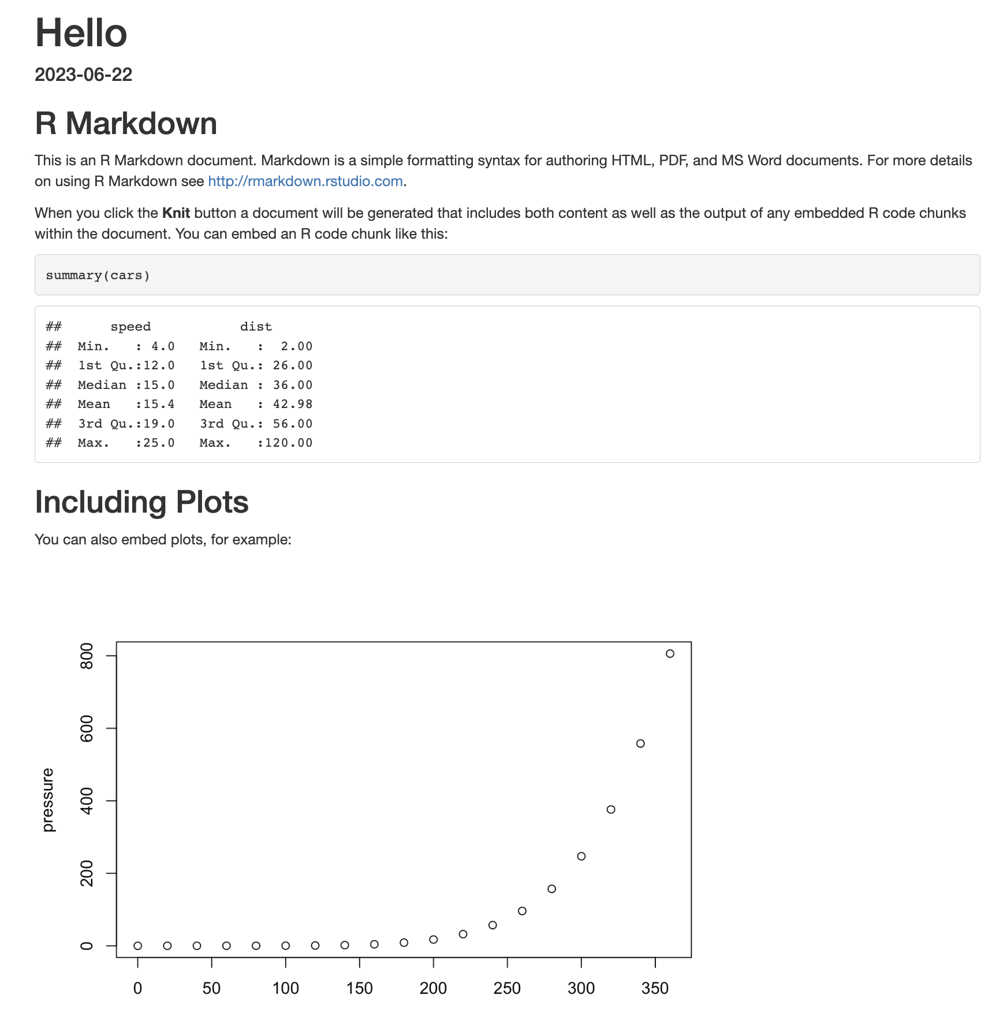
Dream Pipeline 😍
data
.rmd
Notes:
Improve the diapo

Slide 55
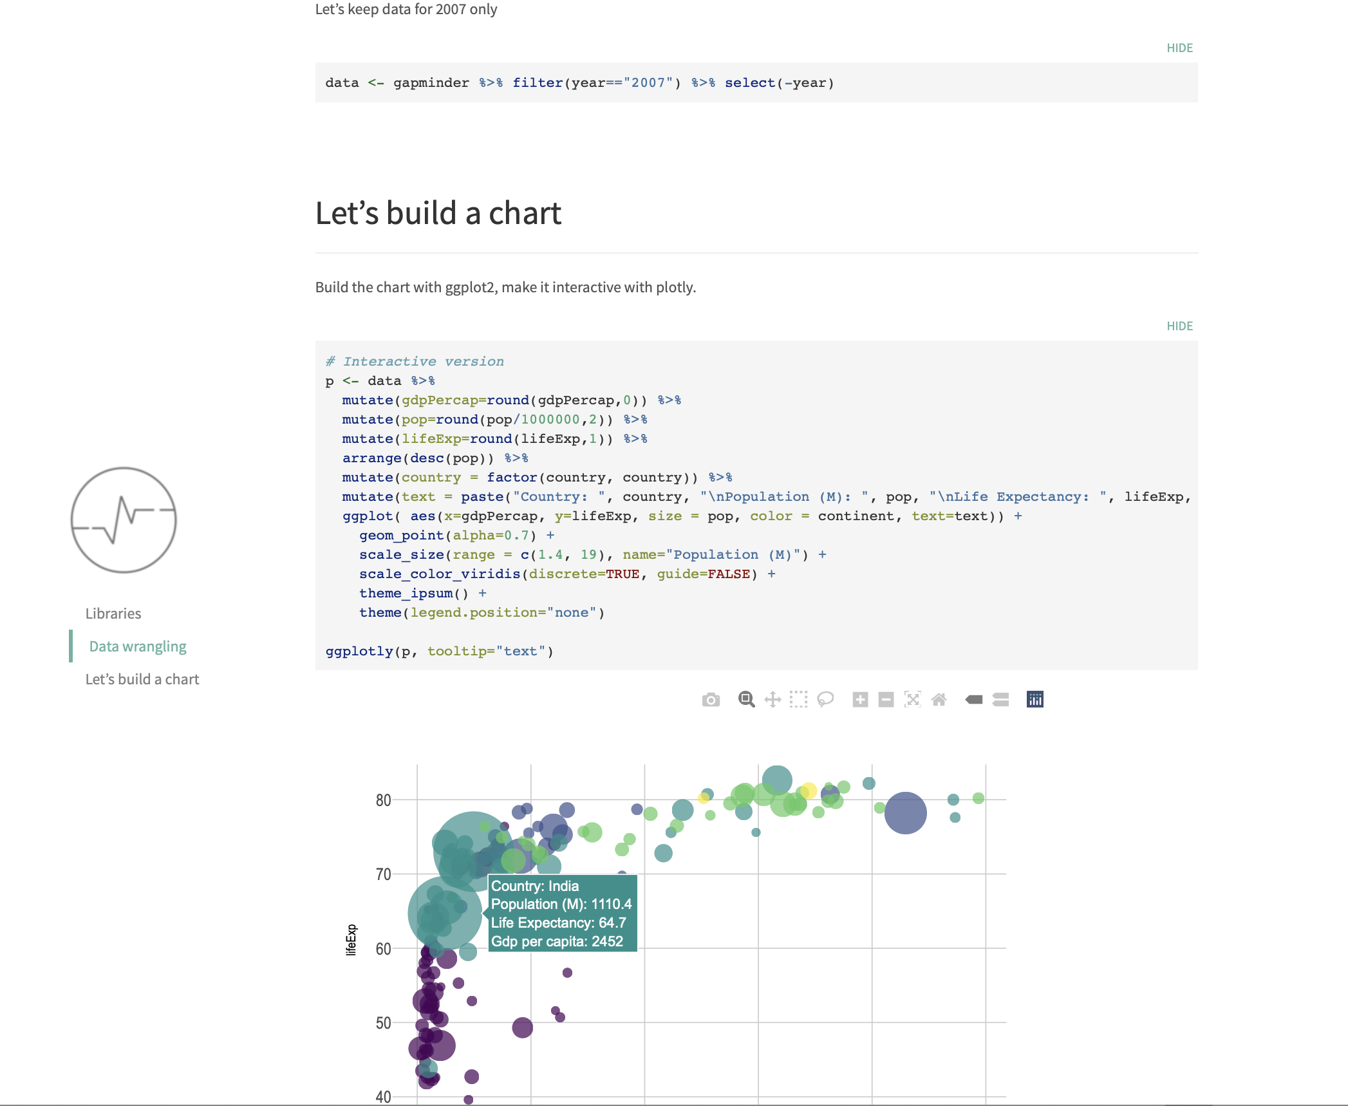
Dream Pipeline 😍
data
.rmd
pretty template
interactive charts
Notes:
Improve the diapo

Slide 56
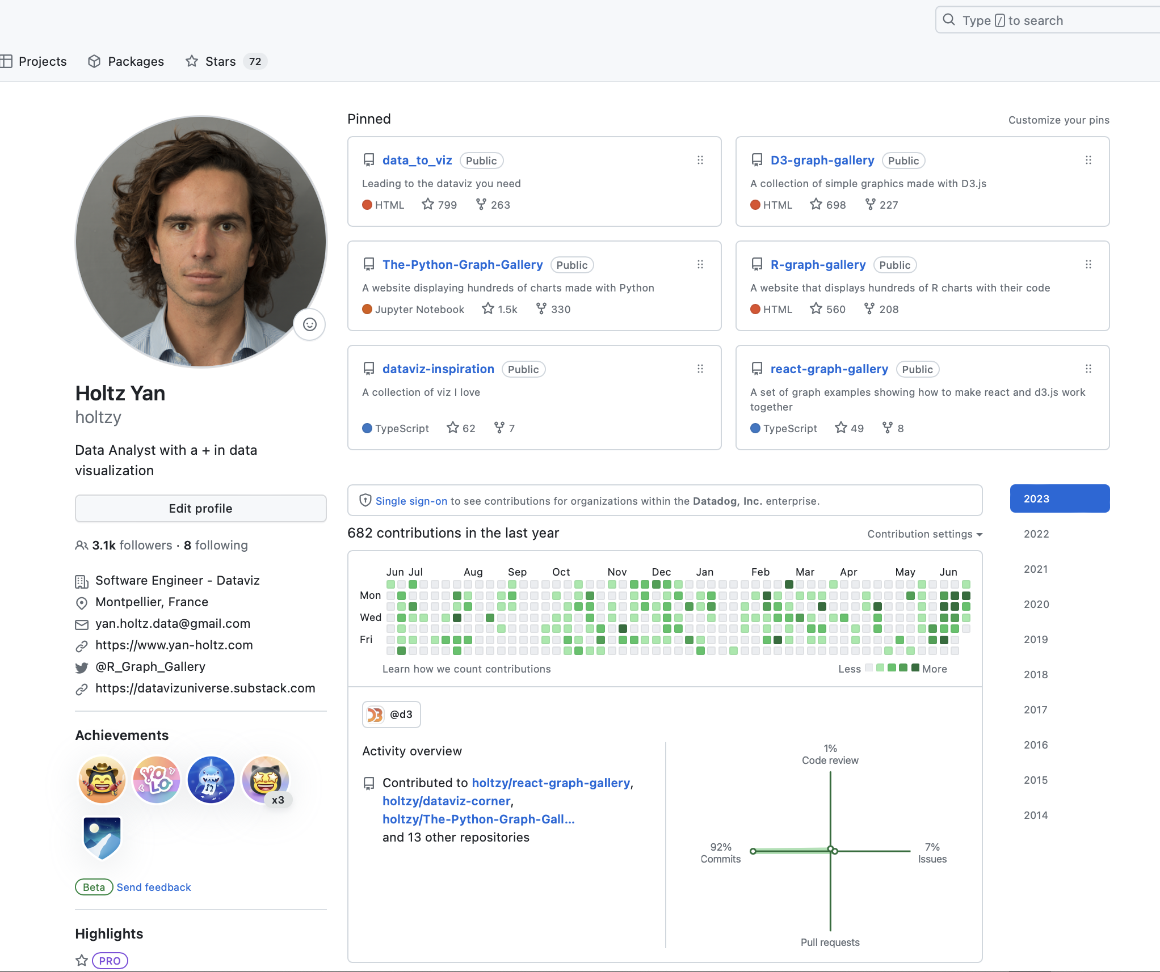
Dream Pipeline
data
.rmd
pretty template
interactive charts
Send to Github
Notes:
Improve the diapo

Slide 57
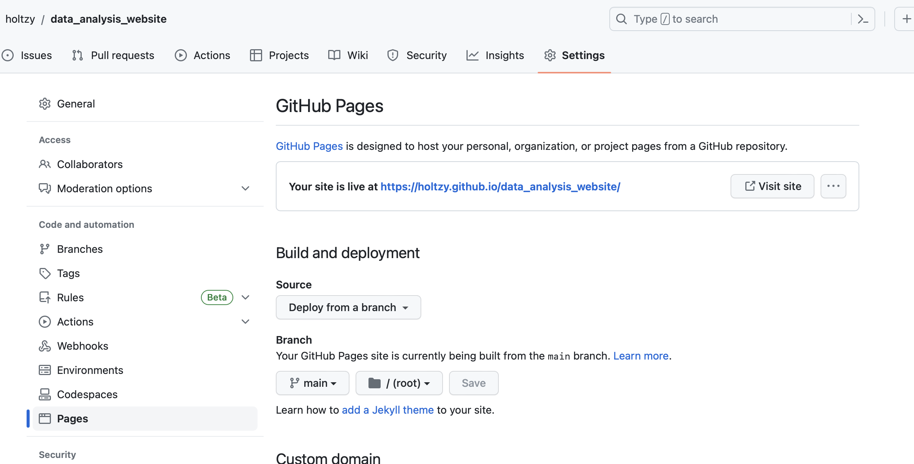
Dream Pipeline
data
.rmd
pretty template
interactive charts
Send to Github
Serve online
Share URL
Notes:
Improve the diapo

Slide 58
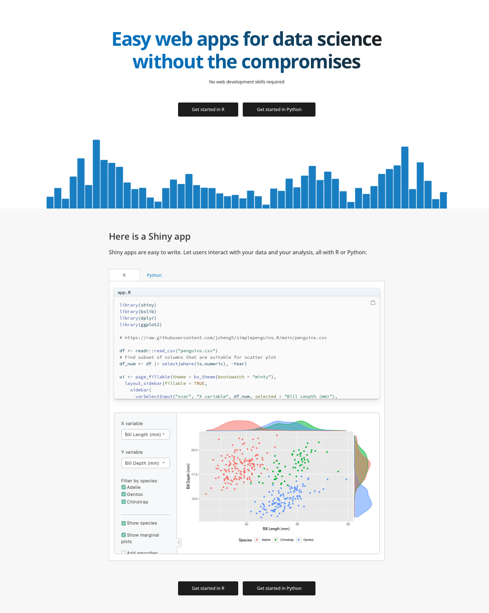

SHINY
PRO
Quick prototyping
Statistical power of R
CON
Do you need a server?
Performance
Benefit the frontend dev ecosystem
✅
✅
✅
Export a dynamic website
Quick prototyping of web app
Statistical power of R on the web

Slide 59
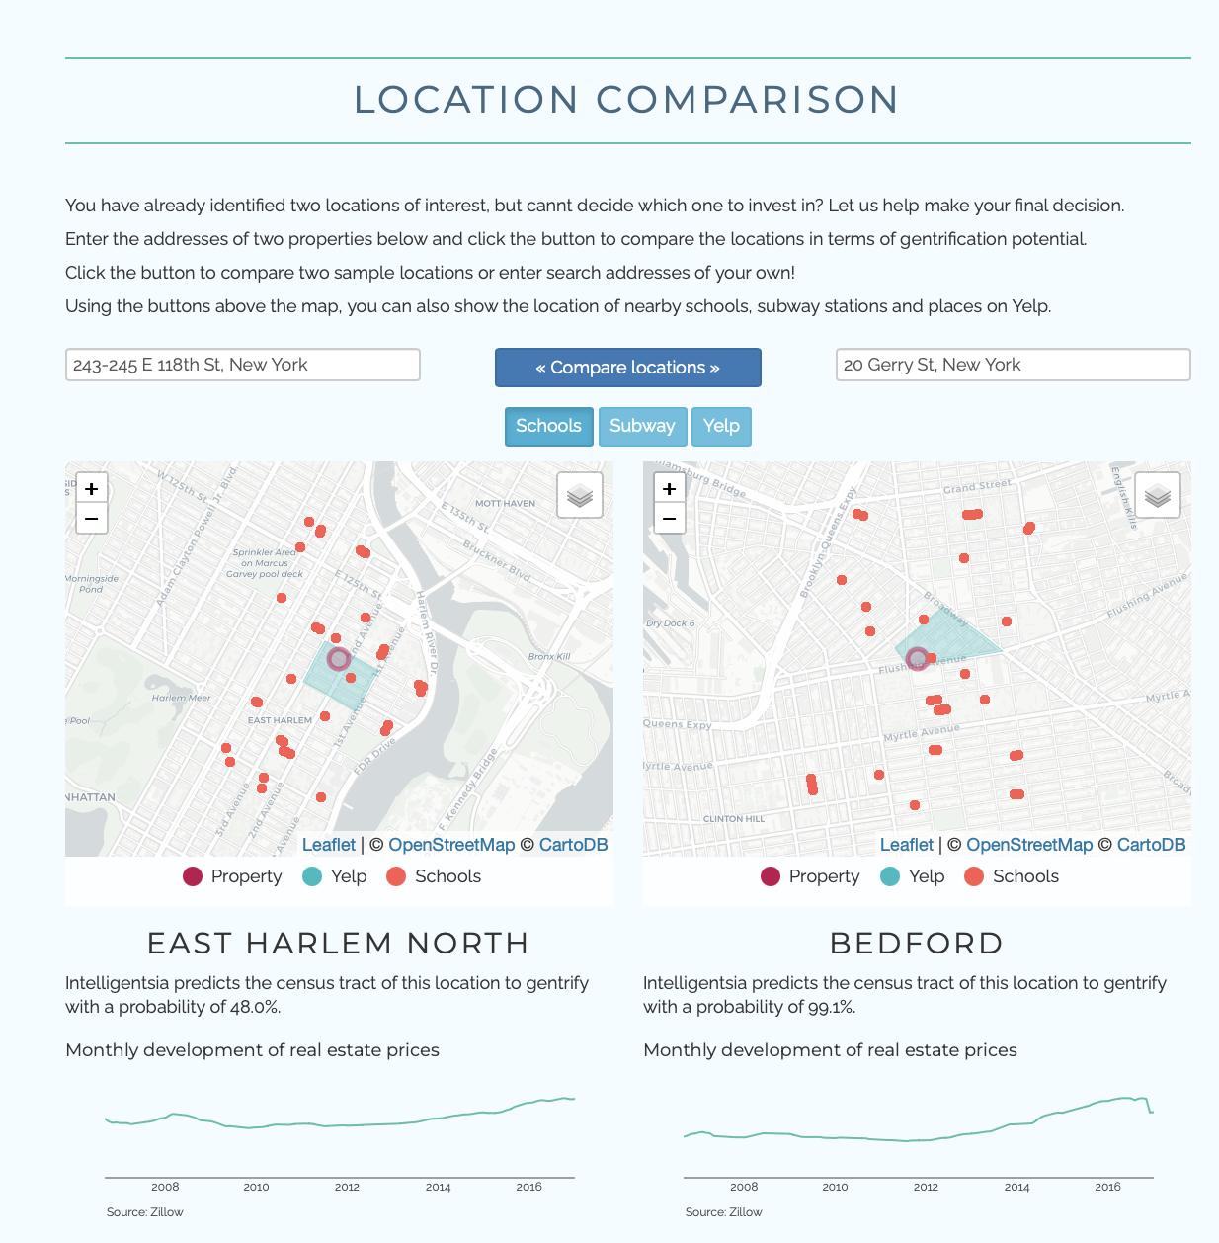
I Shiny !
❤️

Slide 60
Limits ?
Complexity

Slide 61
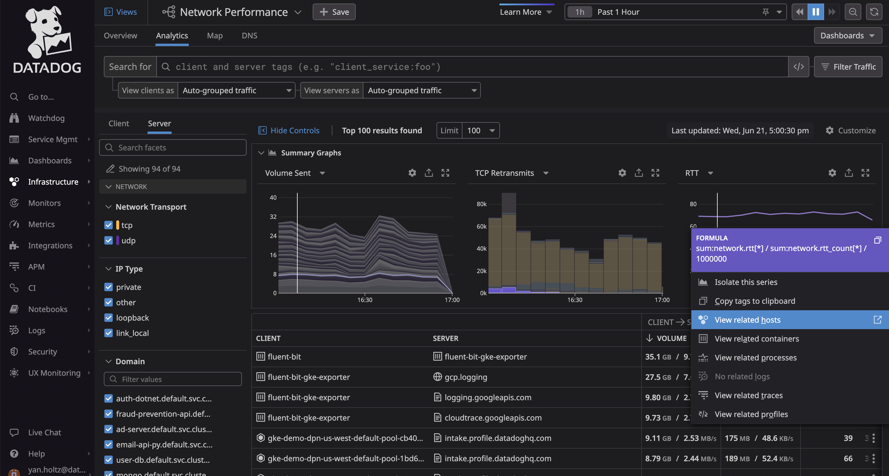
Notes:
We are about 200 devs working on the Frontend of DataDog
More than 1500 devs including the backend

Slide 62
Privacy | Cache | Units | Access right | Scalability | Performance | Loading state | Error notifs
Design System with reusable components
Query parser
100x of pages with lazy loading
State management
Progressive loading
Synced graphs
Context Menu
Auth
Table with windowing
Notes:
We are about 200 devs working on the Frontend of DataDog
More than 1500 devs including the backend

Slide 63
Limits ?
Do you need a server ?

Slide 64

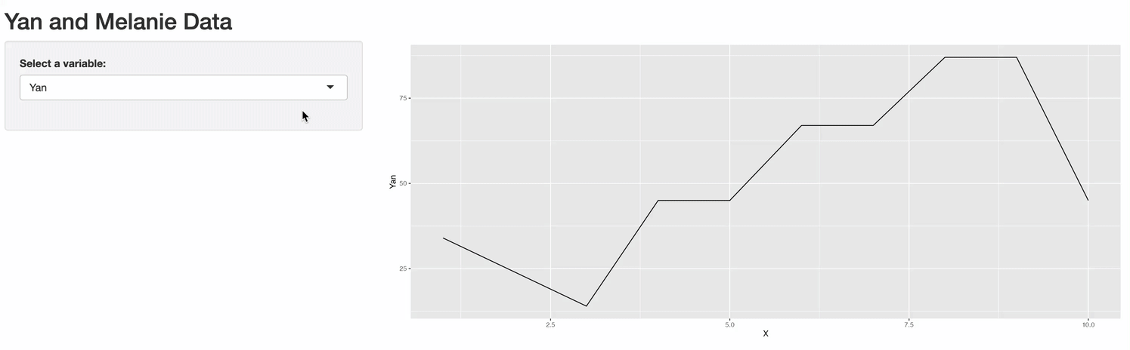
server
browser

Slide 65

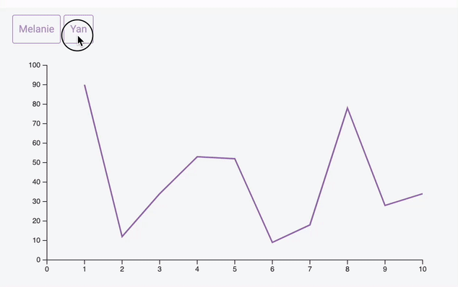
server
browser
server
browser

Slide 66

Notes:
Note: Say that the Python ecosystem has the equivalent tools

Slide 67

Exciting time for dataviz
🔥
R is a solid choice
But there are many others!
Notes:
Exciting time for dataViz
Dataviz is everywhere: ppl know it more, we need it and use it more and more
There are so many tools right now. Take some time to find the one that truly suits your needs
ChatGPT is gonna make our life easier

Slide 68

Exciting time for dataviz
🔥
Charts are everywhere
Notes:
Exciting time for dataViz
Dataviz is everywhere: ppl know it more, we need it and use it more and more
There are so many tools right now. Take some time to find the one that truly suits your needs
ChatGPT is gonna make our life easier

Slide 69

Exciting time for dataviz
🔥
AI is gonna make our life easier
Notes:
Exciting time for dataViz
Dataviz is everywhere: ppl know it more, we need it and use it more and more
There are so many tools right now. Take some time to find the one that truly suits your needs
ChatGPT is gonna make our life easier

Slide 70

data-to-viz.com
dataviz-inspiration.com
Yan-Holtz.com
@r_graph_gallery
R-graph-gallery.com
Python-graph-gallery.com
D3-graph-gallery.com
React-graph-gallery.com
A travel by Yan Holtz
Notes:
Finish by thanking organizers

